Slide 1
National Center of Research Summer Training Project One 2022 Bioinformatics
Faculty of Computers and Artificial Intelligence Cairo University
Bioinformatics Department
Third Level

Slide 2
Heart Disease Prediction
Under Supervision of Dr. Enas M.Fahmy El Houby
National Center of Research
Done by:
Sarah Hesham 20198047
Mariam Hassan 20198081

Slide 3
Over View
Text data was downloaded from NCBI.com .
Text data was converted to excel sheet.
Excel sheet data was processed.
SVM model application.
Logistic Regression model application.
Python programming language used.

Slide 4
Objectives
Learn how to manipulate data in a .txt file and convert it to .xlsx or .csv .
Appling machine learning models to train and test data to predict the occurrence of heart disease for a person ,trying to achieve highest possible accuracy.

Slide 5
About Our Dataset
Human dataset with some attributes regrading humans to predict whether the person will have a heart disease or not, expressed in a binary format (0=No ,1=Yes).

Slide 6
About Our Dataset
Human dataset downloaded from NCBI.com .
Contains 14 attributes:
Age
Sex
Cp
Trestbps
Chol

Slide 7
About Our Dataset
fbs
Restecg
Thalach
Exang
Oldpeak
Slope
Ca
Thal
Prediction (the predicted attribute)

Slide 8
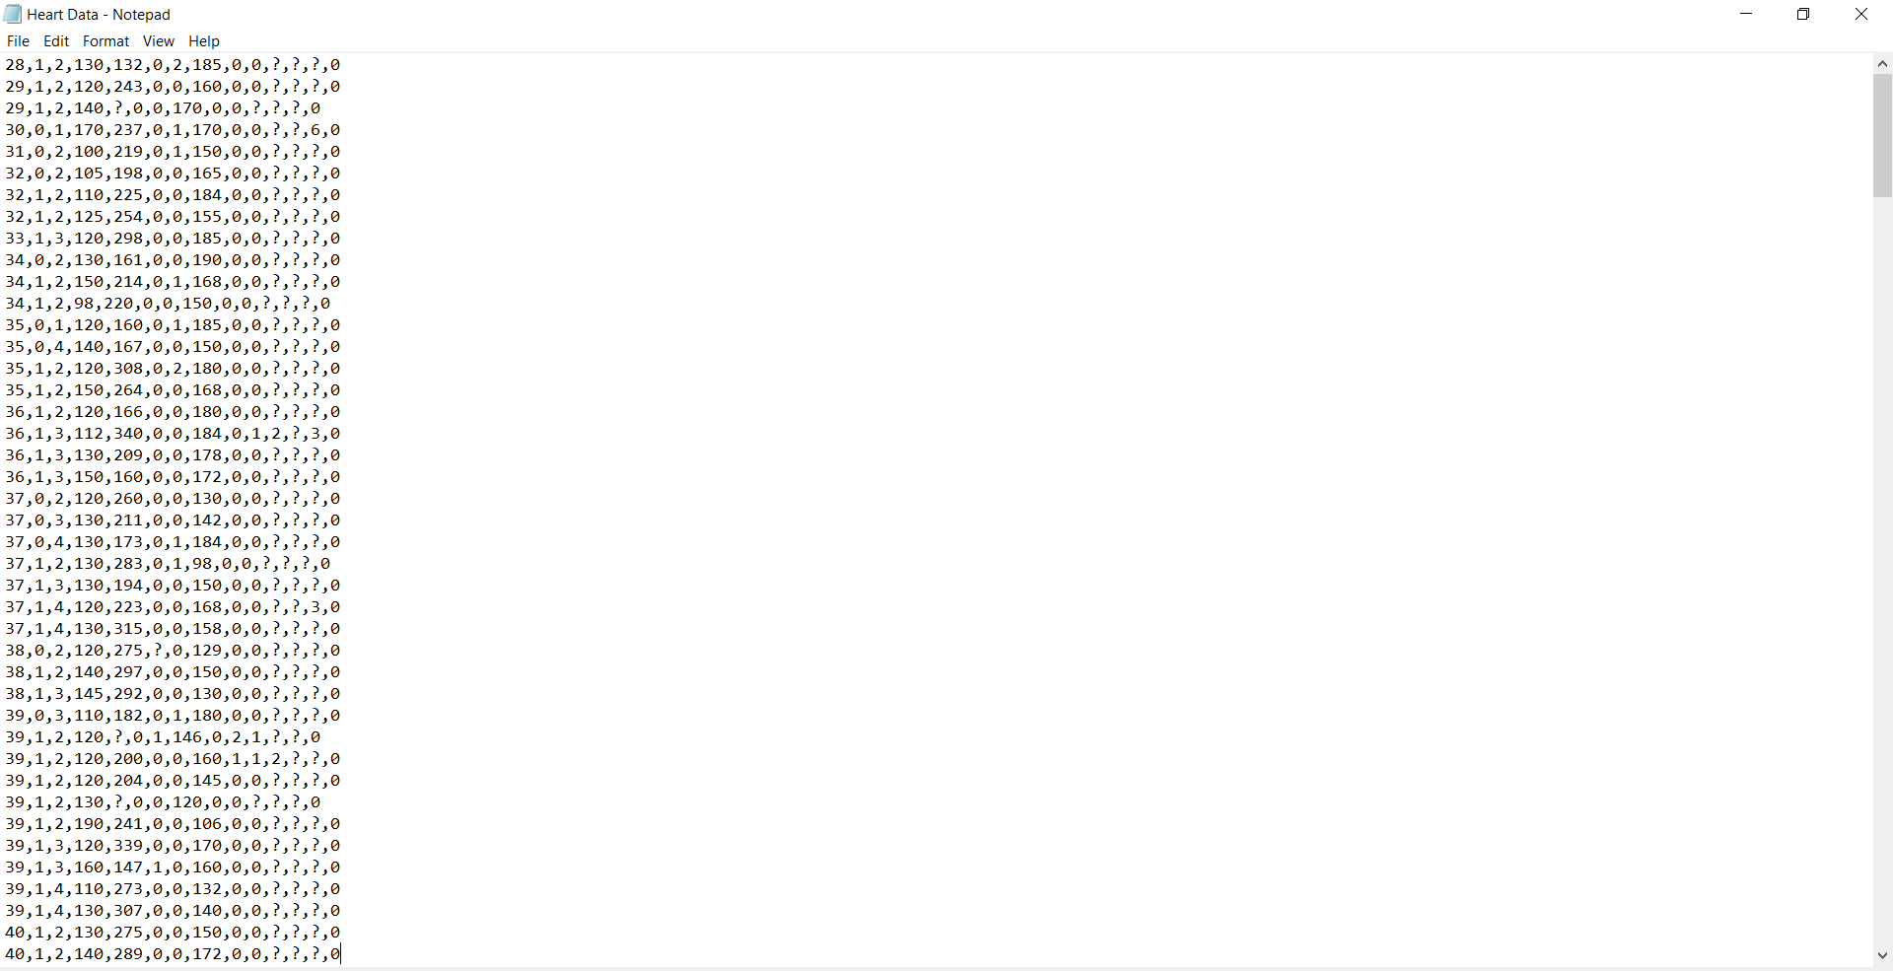
Shape of Dataset Text File

Slide 9
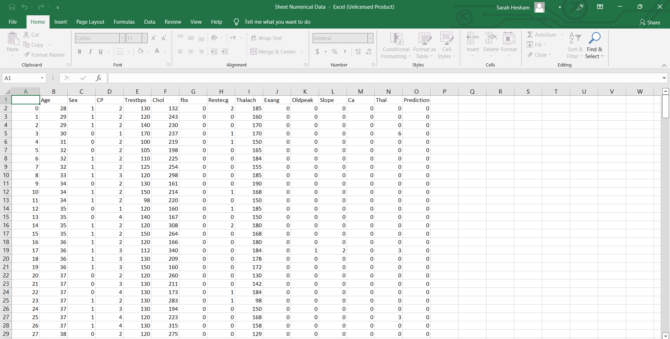
After Conversion to Excel File and Processing it

Slide 10
Applying SVM model
Train data was 80% and test was 20%
Accuracy was 96.6%
Kernel used rbf

Slide 11
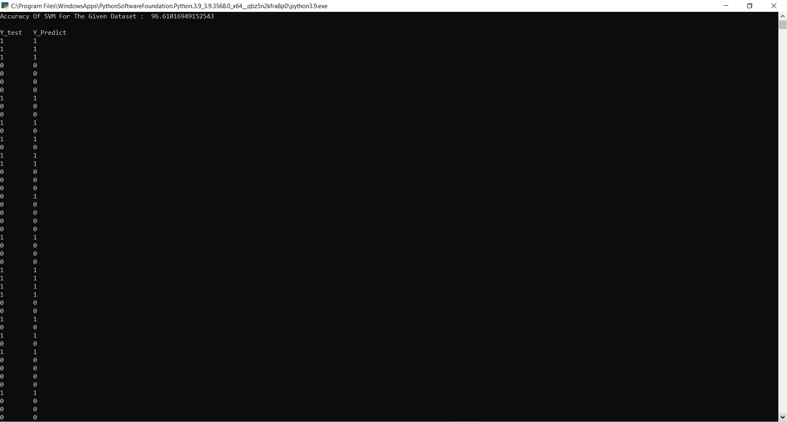
SVM Output

Slide 12
SVM Python Code
#Importing the dataset
#import pandas as pd
#data = pd.read_excel("Sheet Numerical Data.xlsx")
#data.to_csv("Sheet Numerical Data.csv")
import pandas as pd
data = pd.read_csv("Sheet Numerical Data.csv")

Slide 13
SVM Python Code
#Splitting the dataset into training and test samples
from sklearn.model_selection import train_test_split
training_set, test_set = train_test_split(data, test_size = 0.2, random_state = 1)
#Classifying the predictors and target
X_train = training_set.iloc[:,0:13].values
Y_train = training_set.iloc[:,14].values
X_test = test_set.iloc[:,0:13].values
Y_test = test_set.iloc[:,14].values

Slide 14
SVM Python Code
#Initializing Support Vector Machine and fitting the training data
from sklearn.svm import SVC
classifier = SVC(kernel='rbf', random_state = 1)
classifier.fit(X_train,Y_train)
#Predicting the classes for test set
Y_pred = classifier.predict(X_test)
#Attaching the predictions to test set for comparing
test_set["New Prdiction"] = Y_pred

Slide 15
SVM Python Code
#Calculating the accuracy of the predictions
from sklearn.metrics import confusion_matrix
cm = confusion_matrix(Y_test,Y_pred)
accuracy = float(cm.diagonal().sum())/len(Y_test)*100
print("Accuracy Of SVM For The Given Dataset : ", accuracy,"\n")
from sklearn.svm import SVC
classifier = SVC(kernel='rbf', random_state = 1)
classifier.fit(X_train,Y_train)

Slide 16
SVM Python Code
print("Y_test \t Y_Predict")
for i in range(len(Y_test)):
print(str(Y_test[i])+" \t "+str(Y_pred[i]))

Slide 17
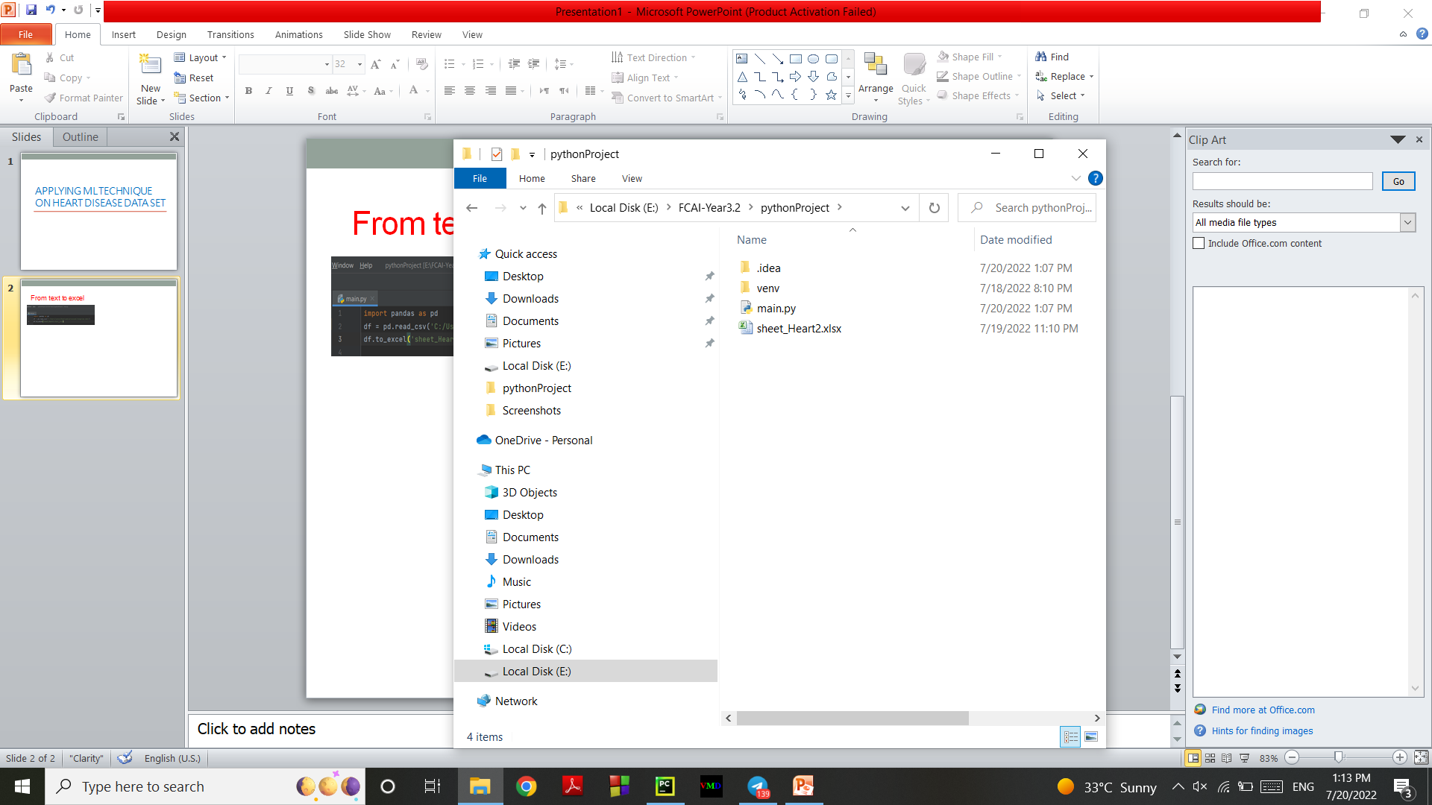
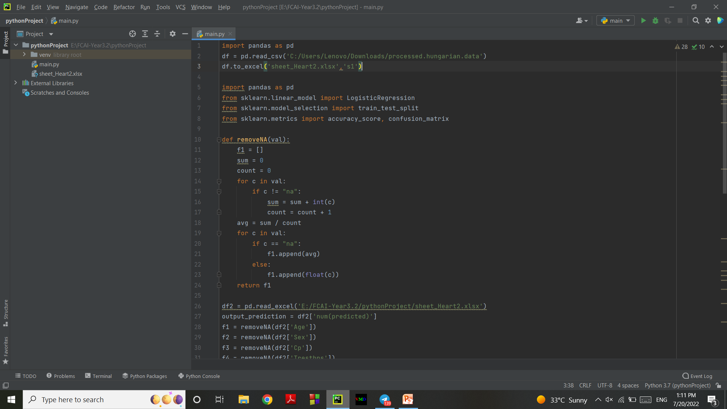
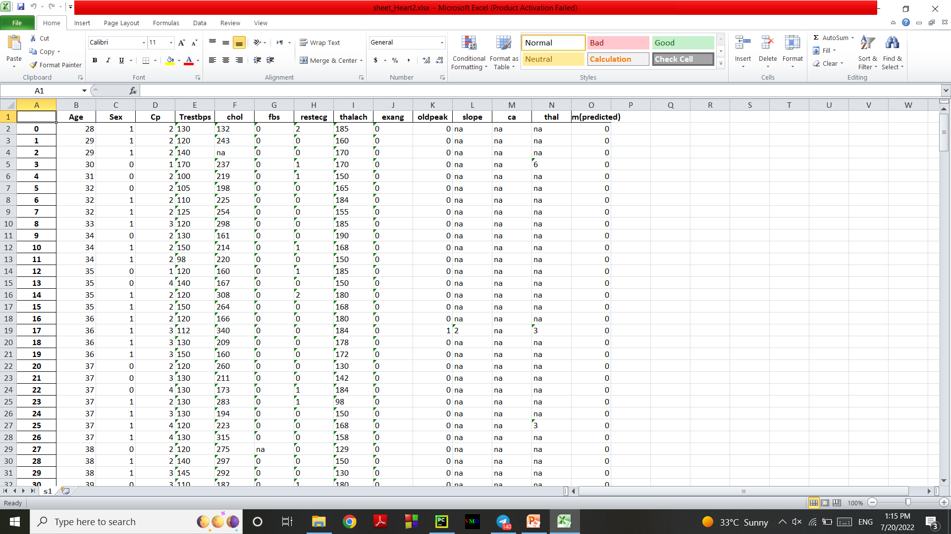
From text to excel

Slide 18
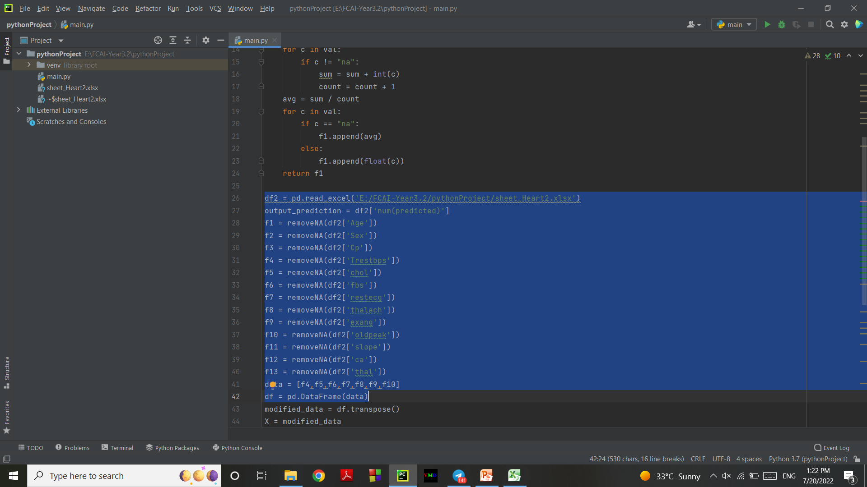
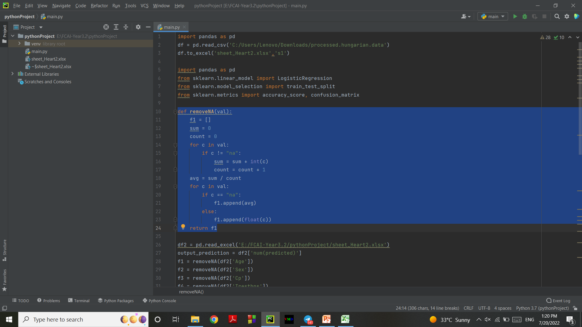
Clearing Data and handling missed values Technique used : Replacing all missing values with Average of each column
Function to calculate average for each column
2. Applying function on all features

Slide 19
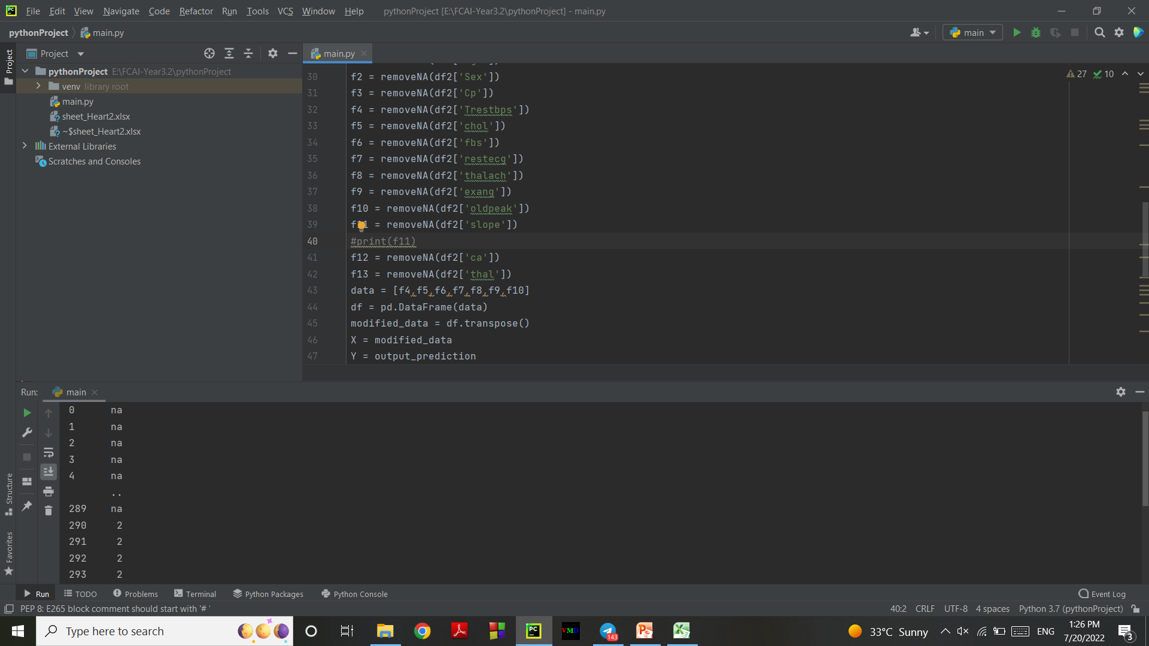

Before and After applying the function

Slide 20
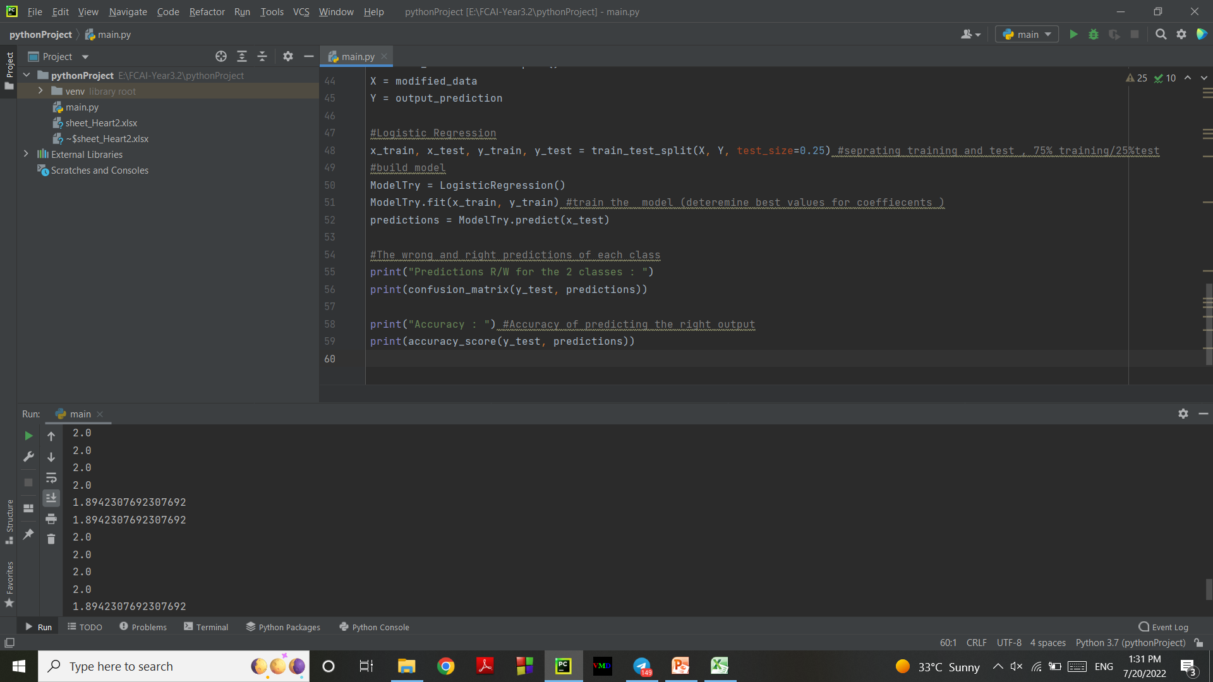
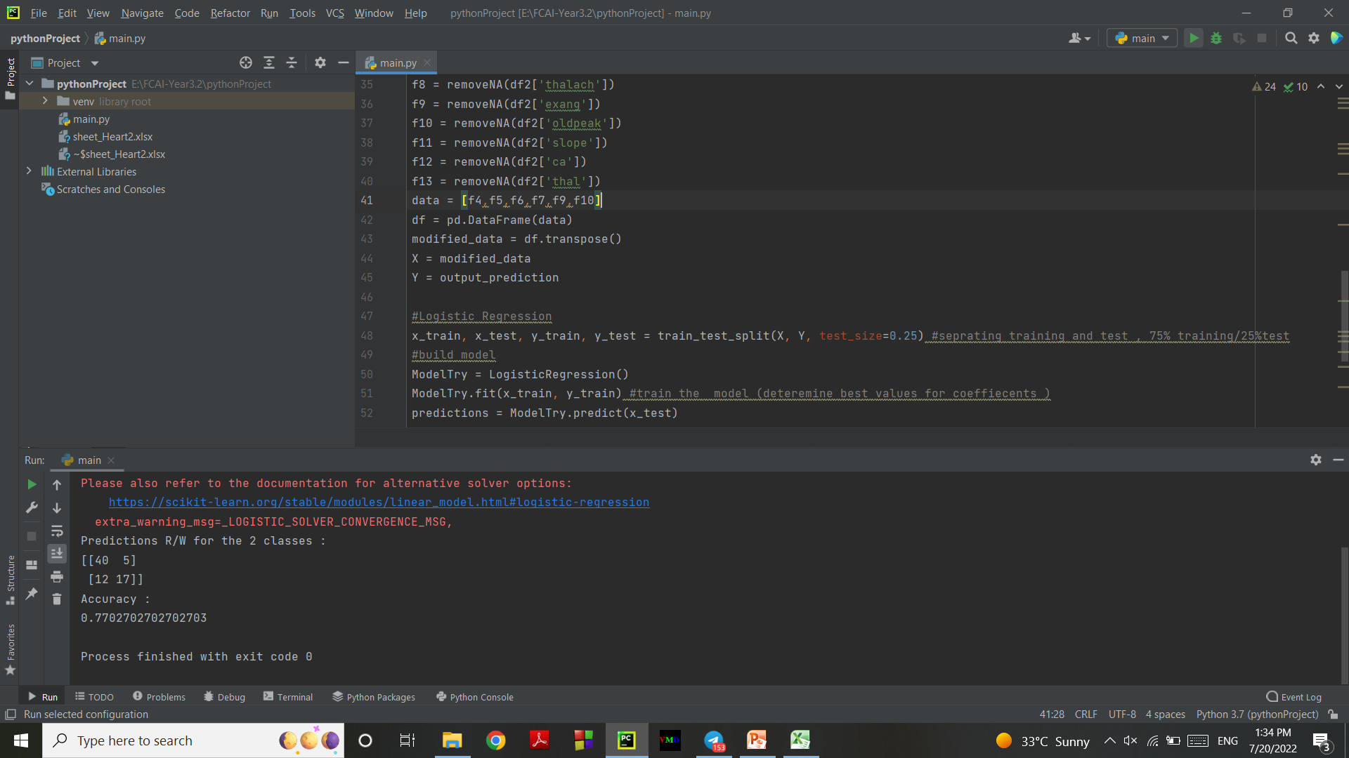

Applying Logistic regression
With 4 features
With 6 features

Slide 21
Task
Compare “Q9ZGE9” protein sequence with itself ?

Slide 22
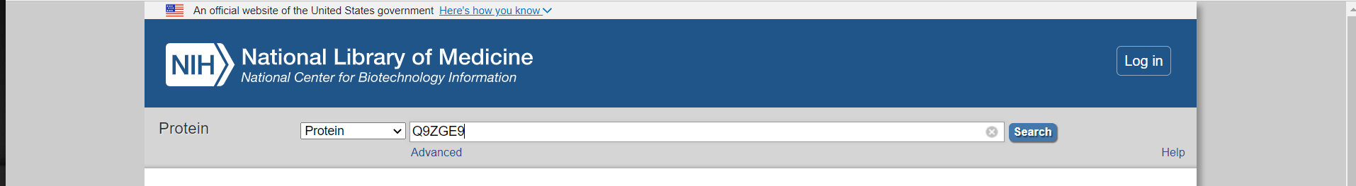
Get Protein Sequence From NCBI

Slide 23
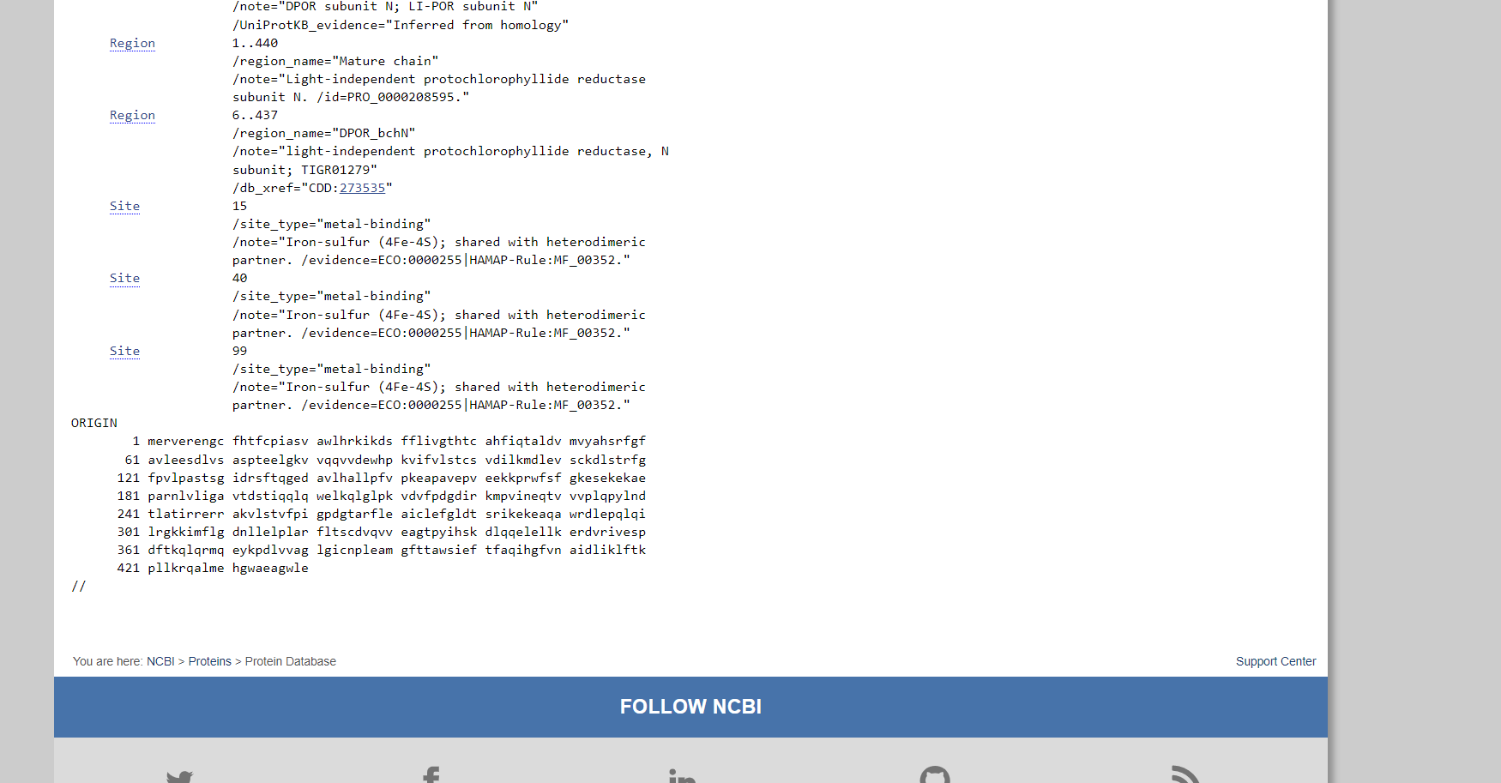
Copy Sequence

Slide 24
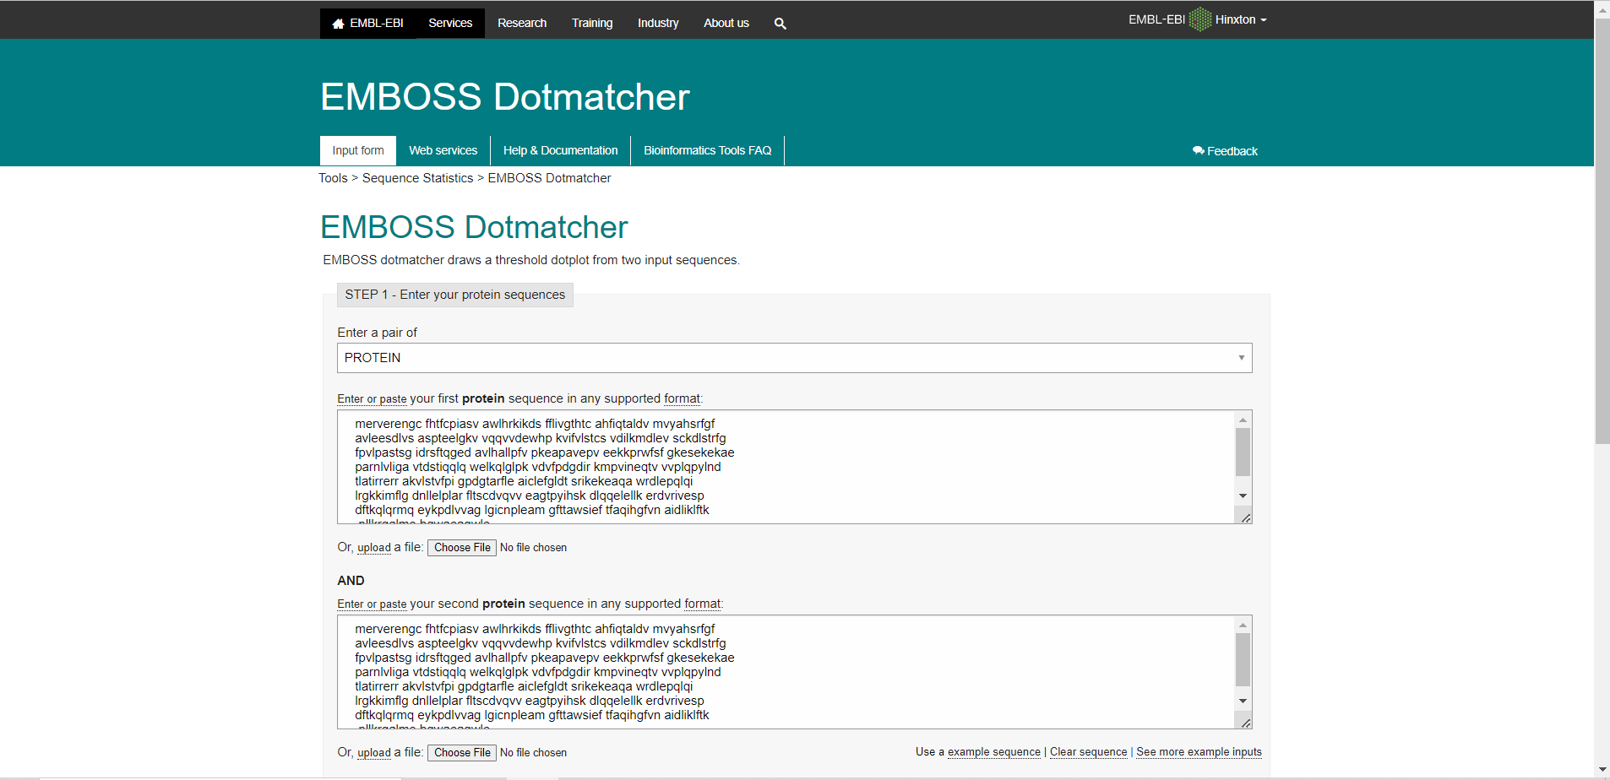
EMBOSS Dotmatcher

Slide 25
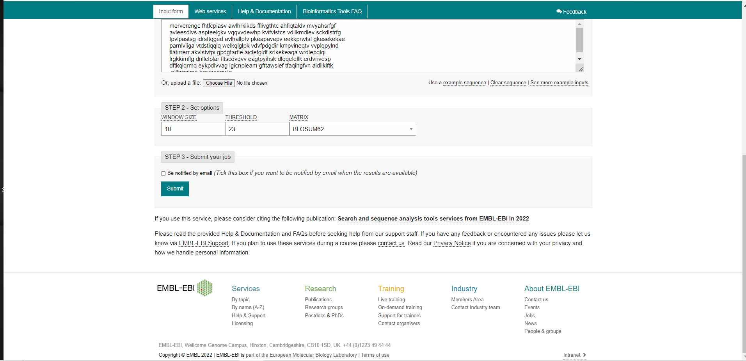
EMBOSS Dotmatcher

Slide 26
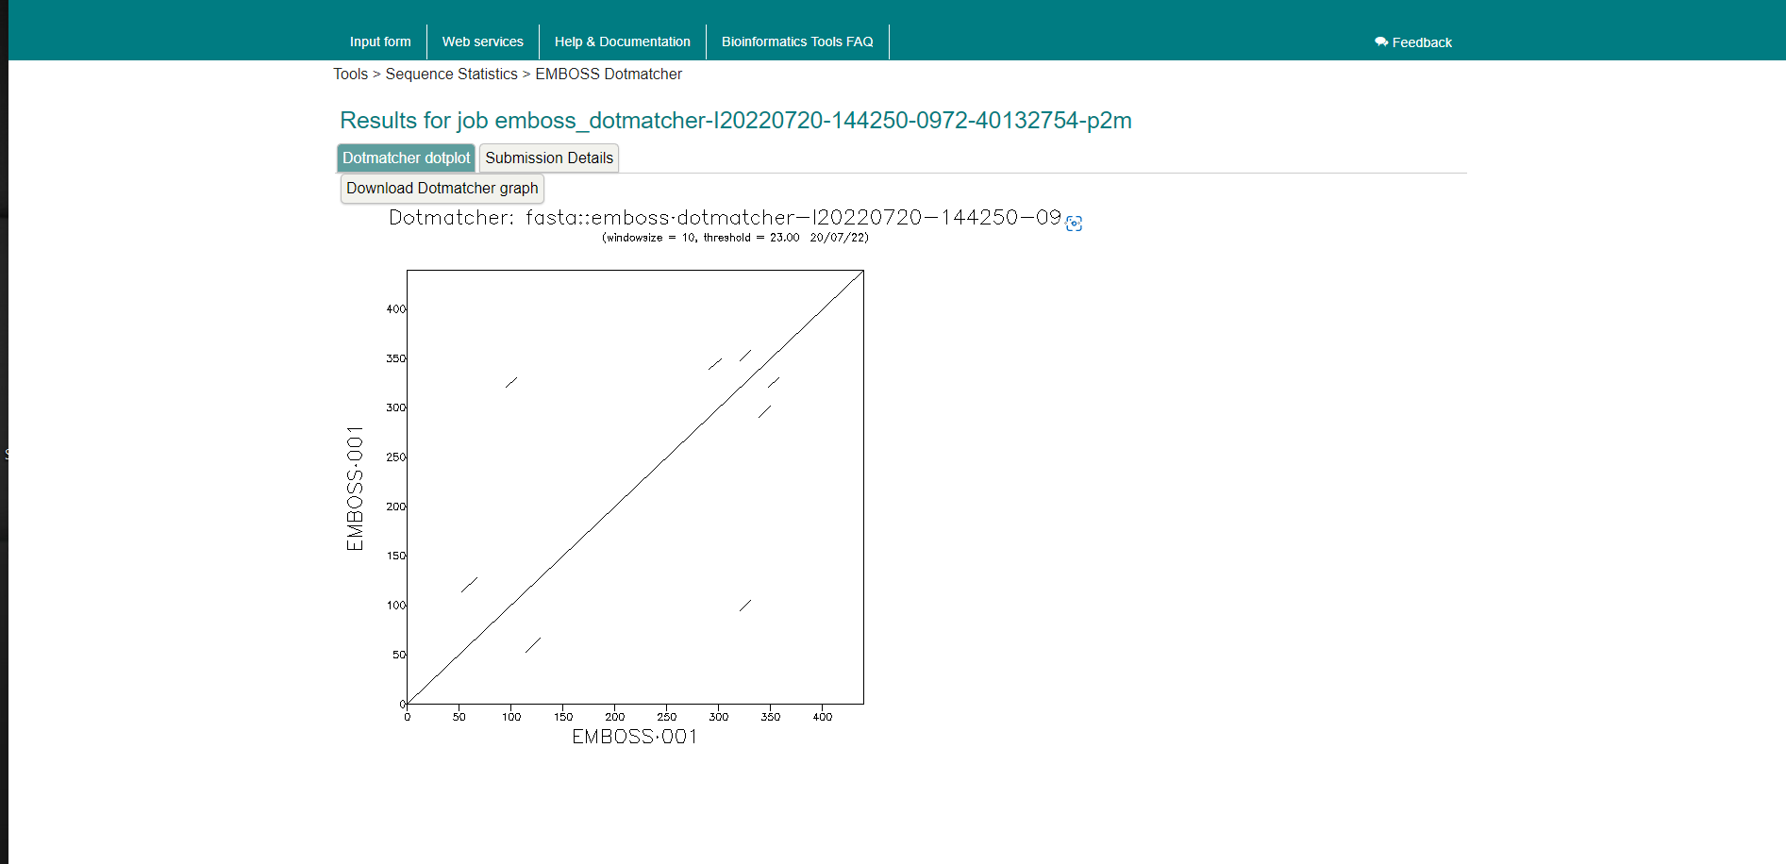
Result

Slide 27
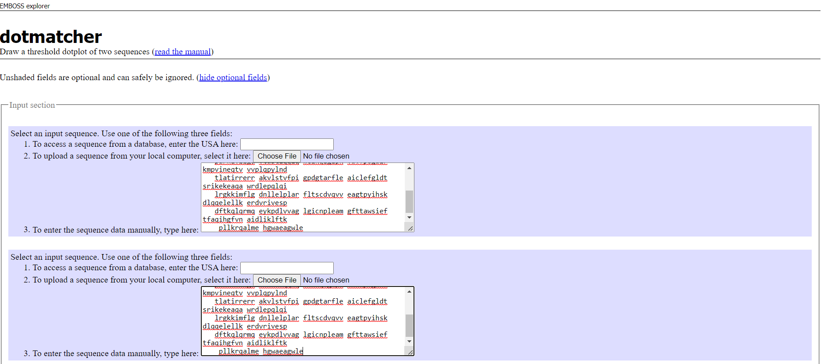
Dotmatcher

Slide 28
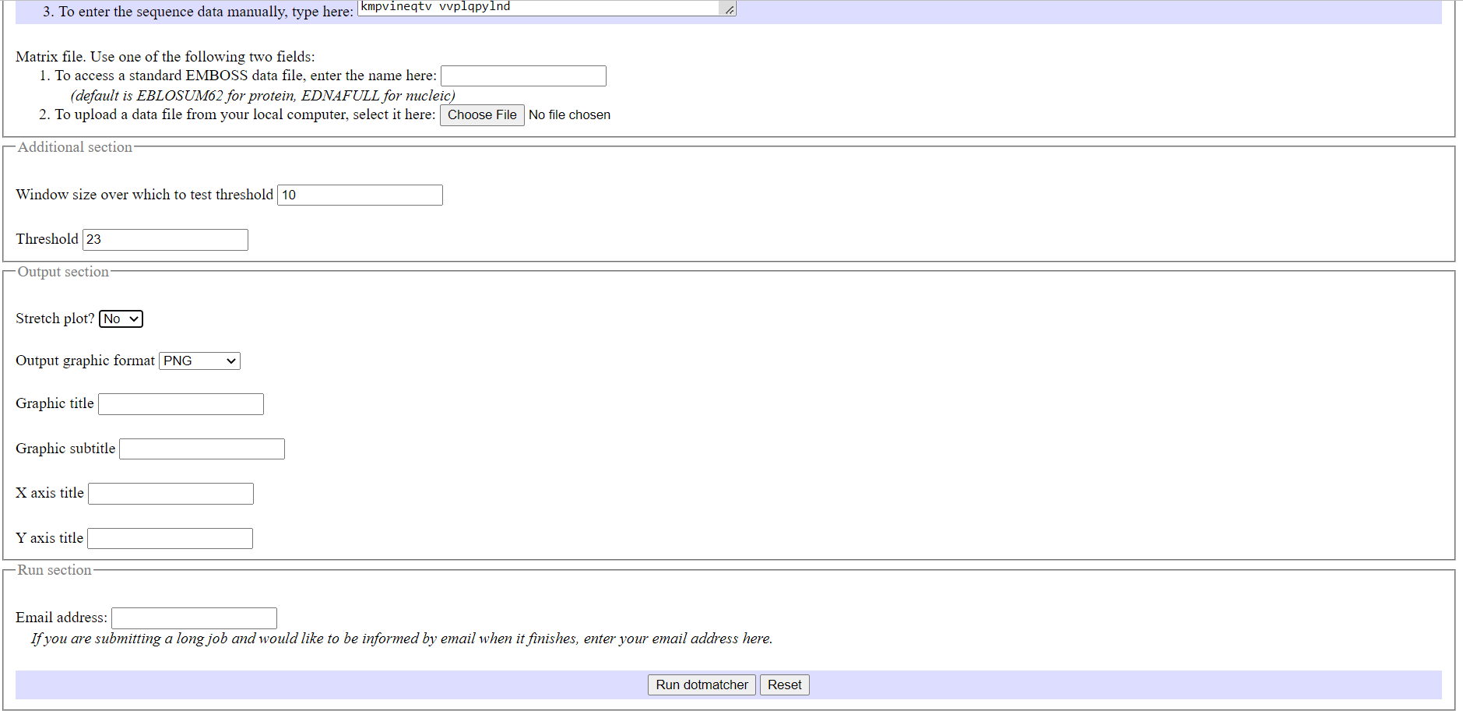
Dotmatcher

Slide 29
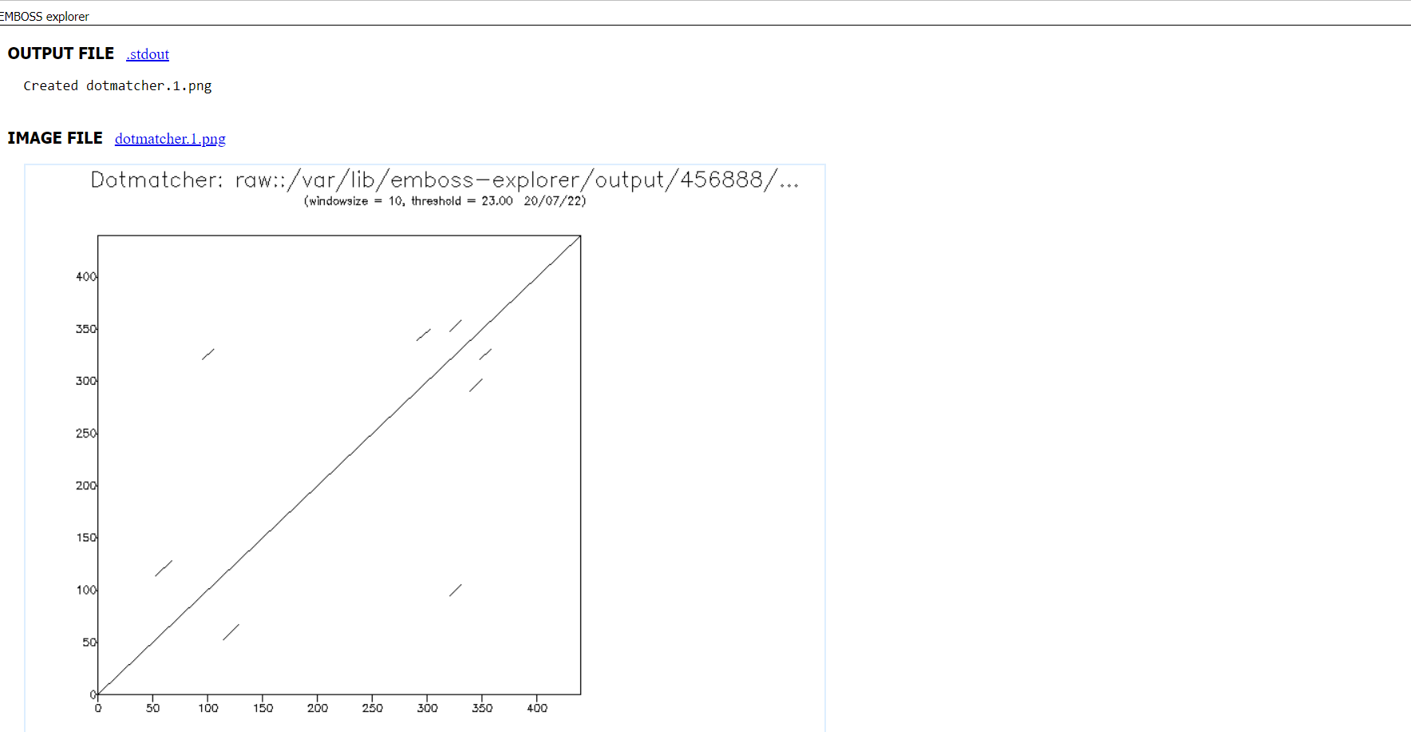
Result

Slide 30
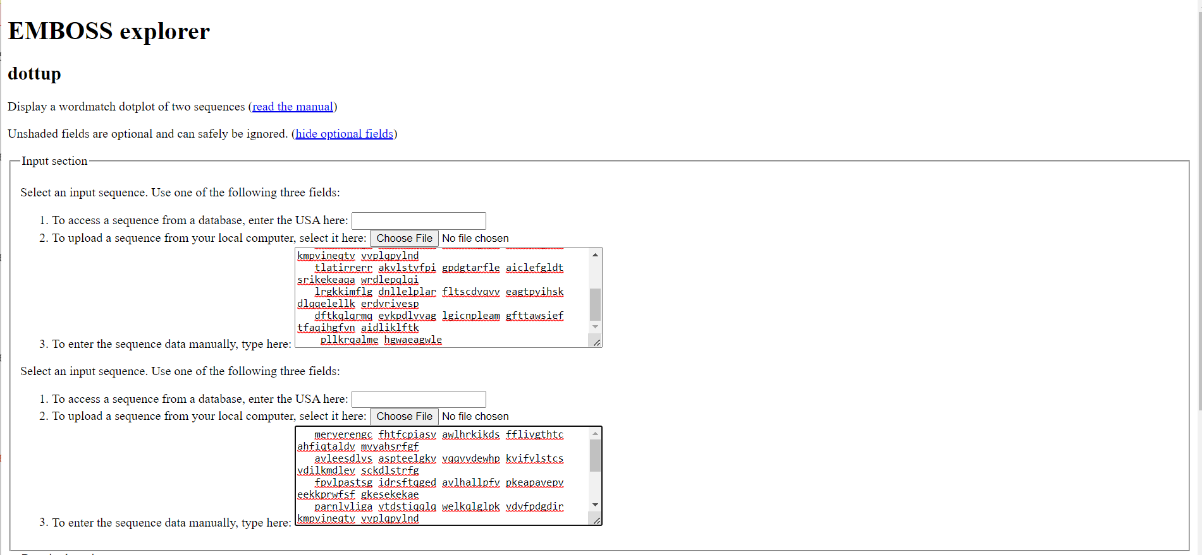
EMBOSS explorer

Slide 31
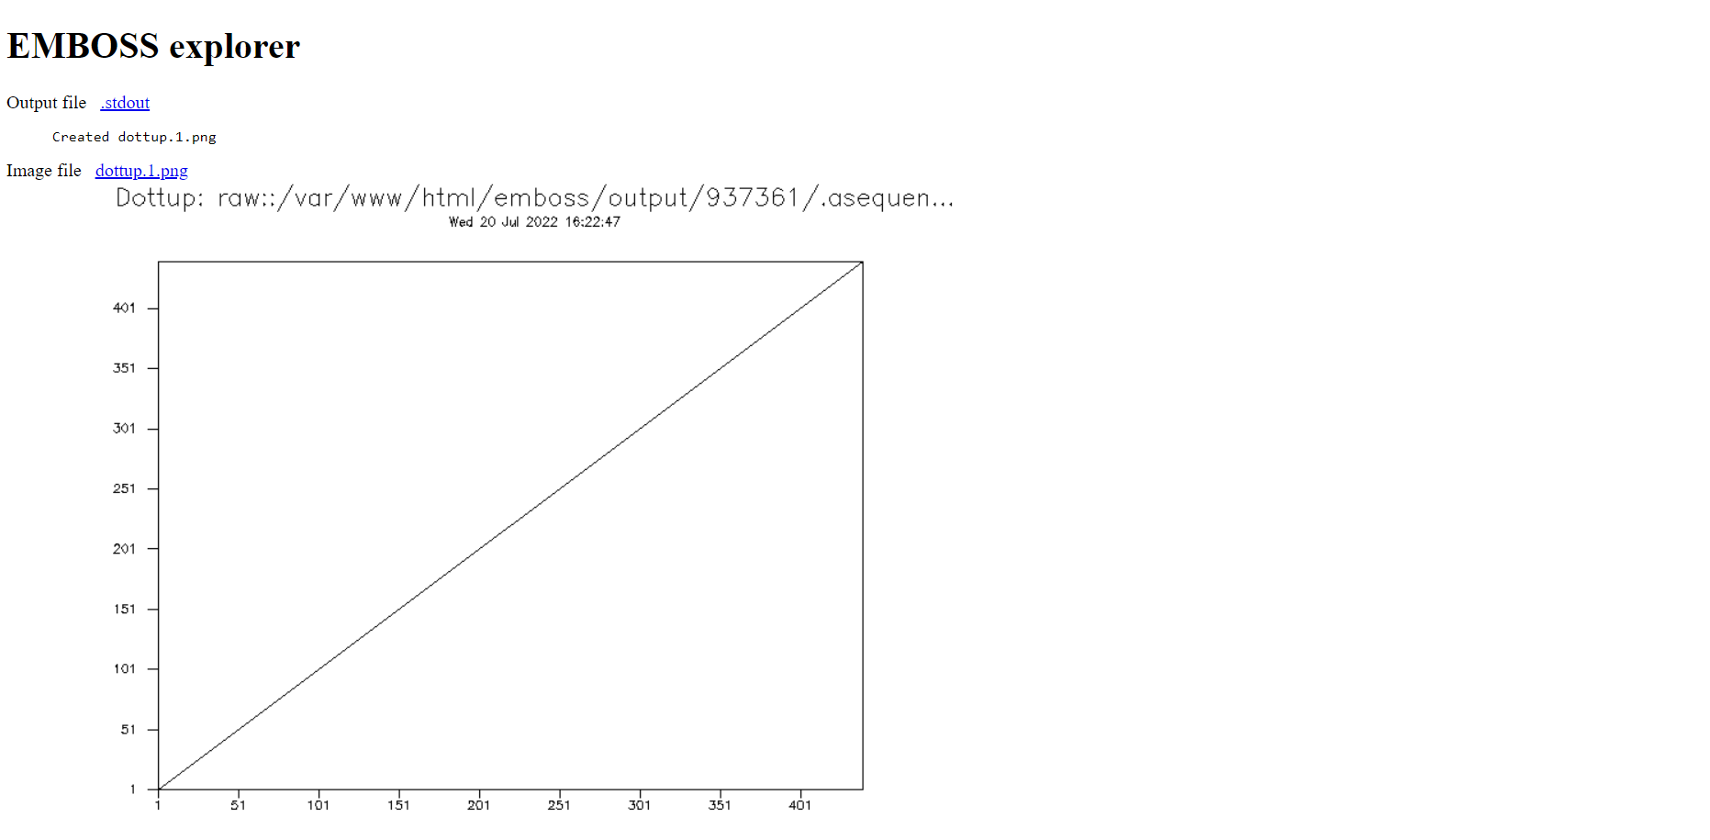
Result

Slide 32
Task
Compare “Q9ZGE9” protein sequence with “Q9ZGEI” (I =1..n) ?
We choose Q9ZGE3

Slide 33
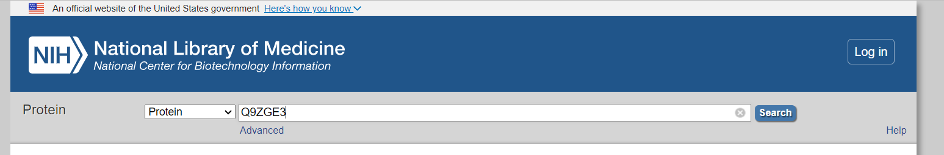
Get Second Protein Sequence From NCBI

Slide 34
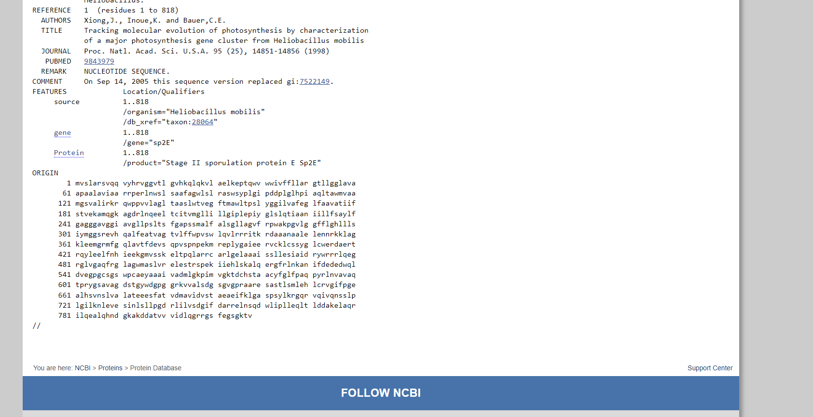
Copy Sequence

Slide 35
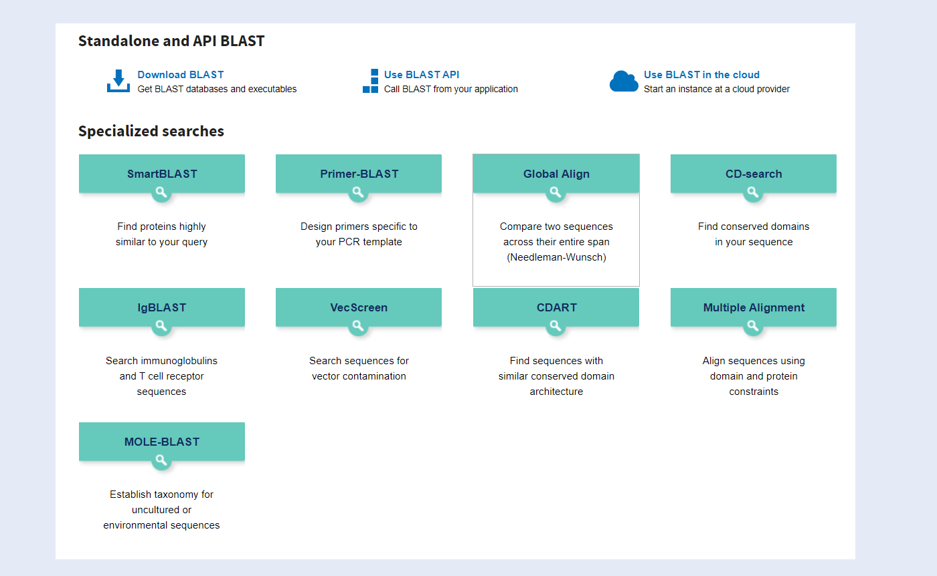
NCBI BLAST Tool

Slide 36
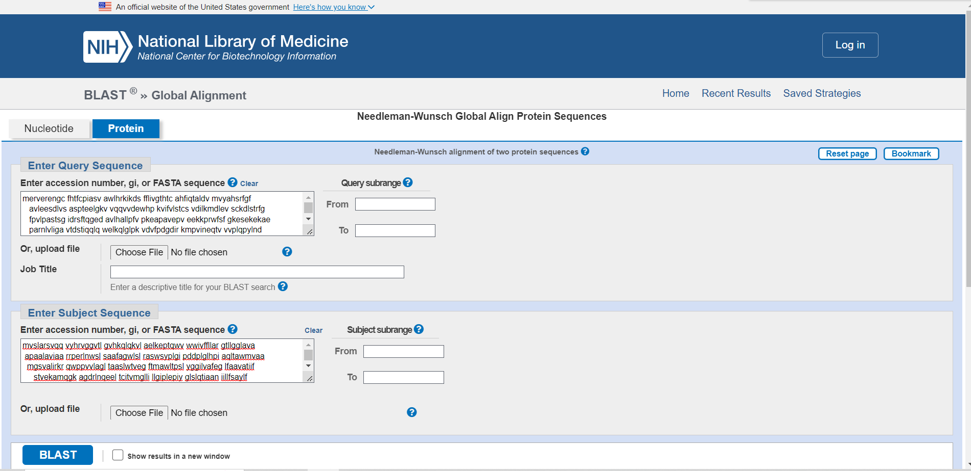
Enter Sequences

Slide 37
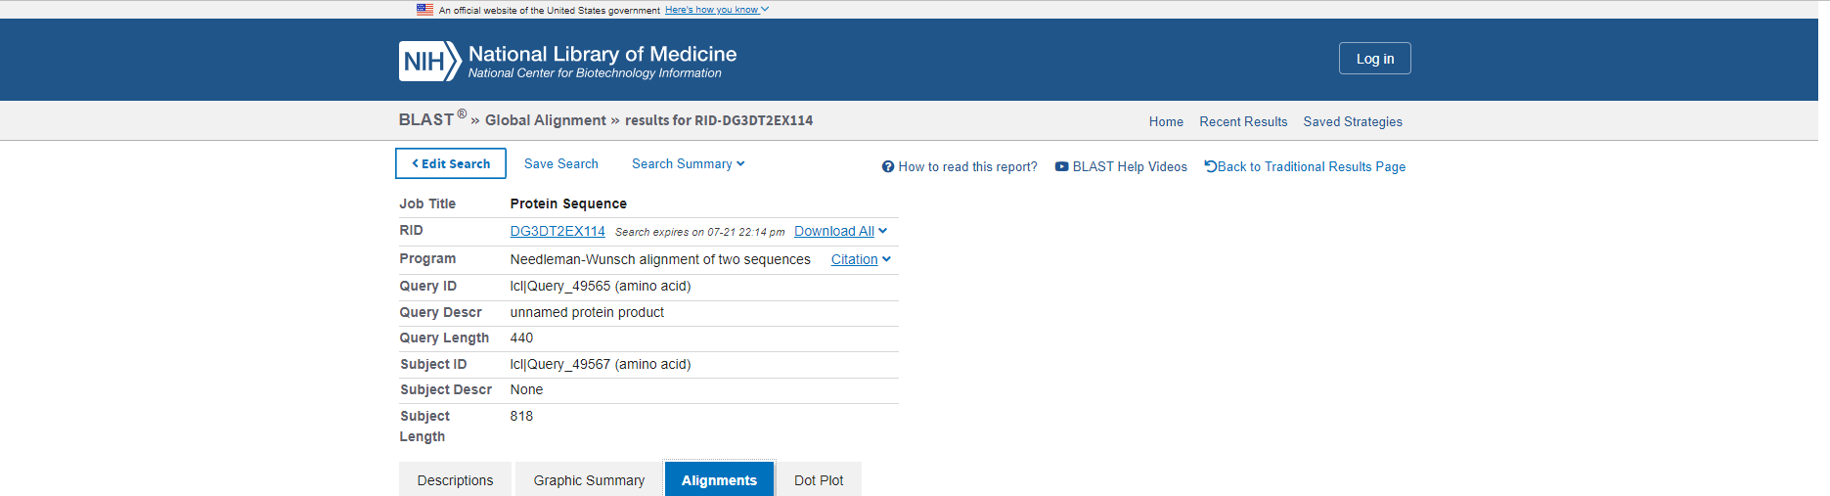
Result

Slide 38
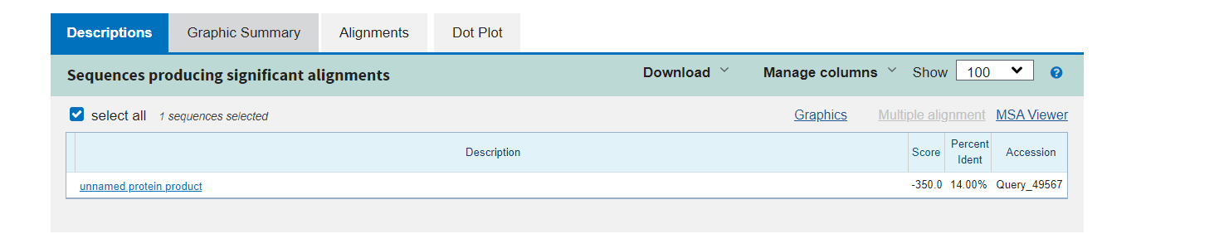
Result Descriptions

Slide 39
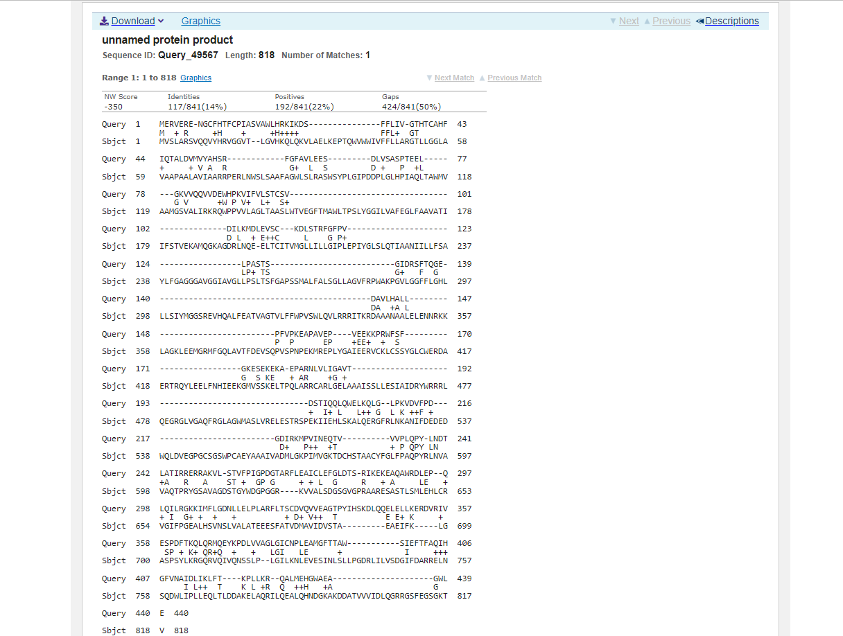
Result Alignments

Slide 40
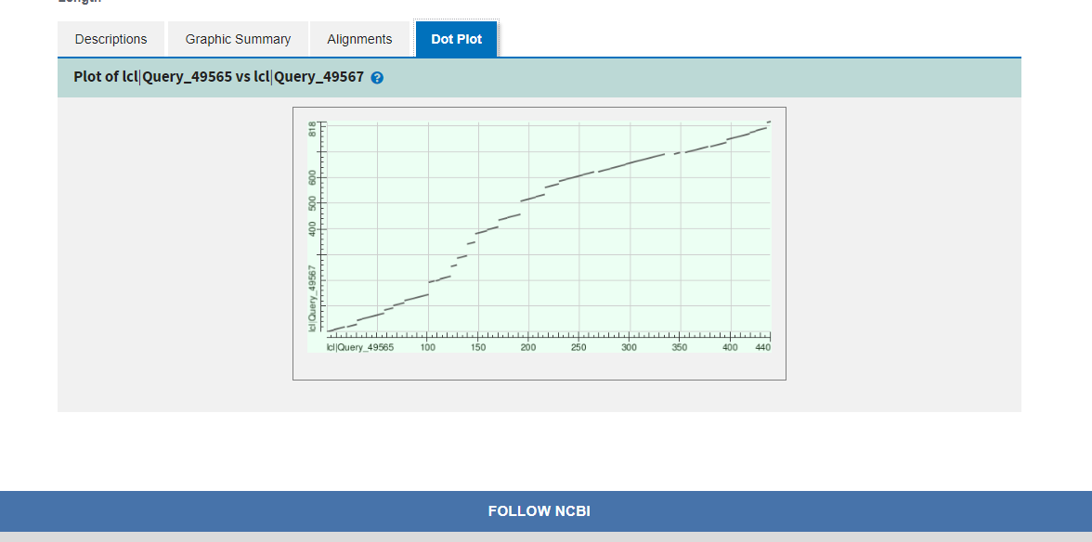
Result Dot Plot

Slide 41
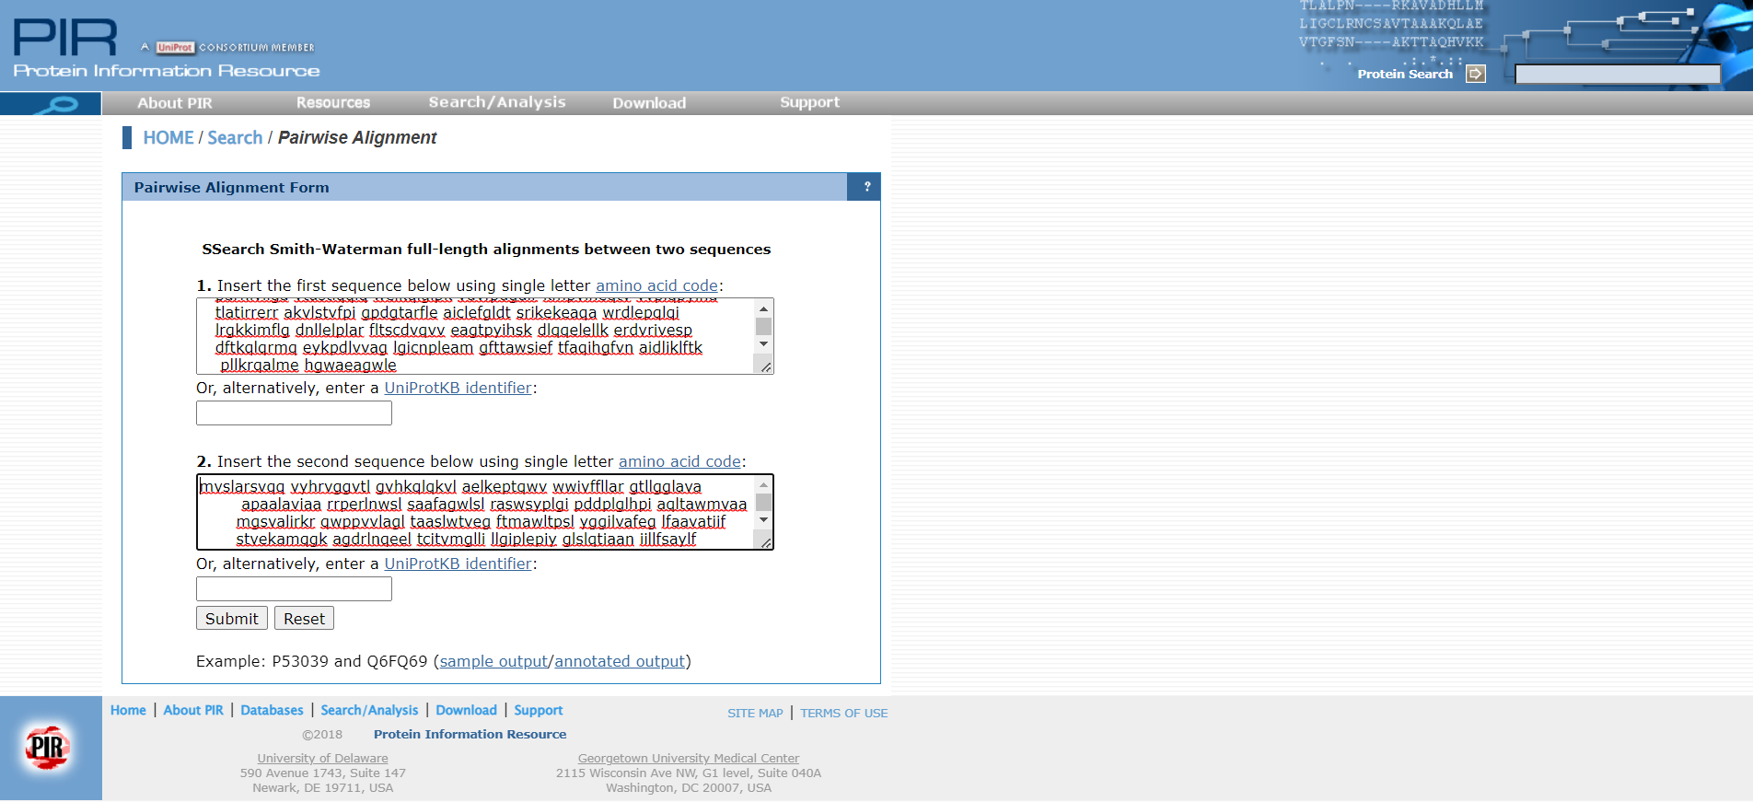
PIR Tool

Slide 42
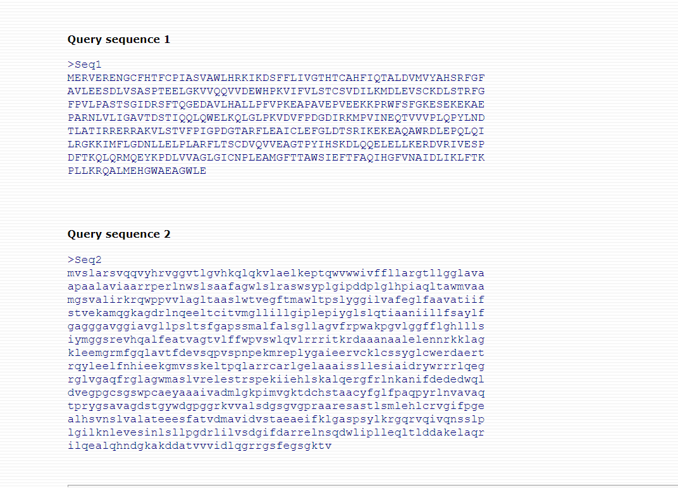
Result

Slide 43
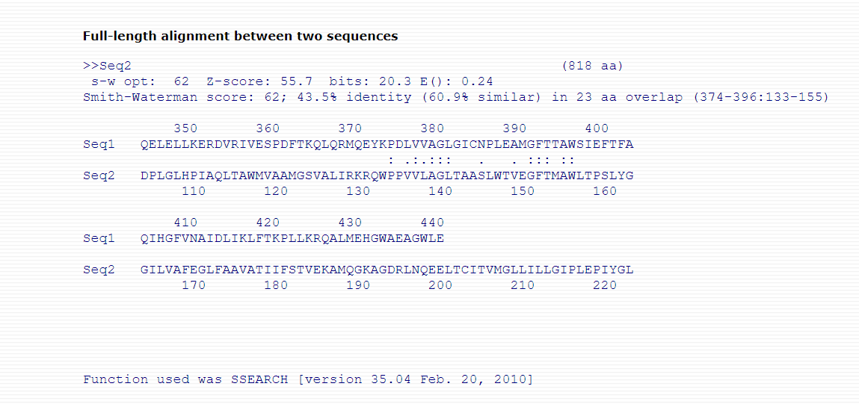
Result

Slide 44
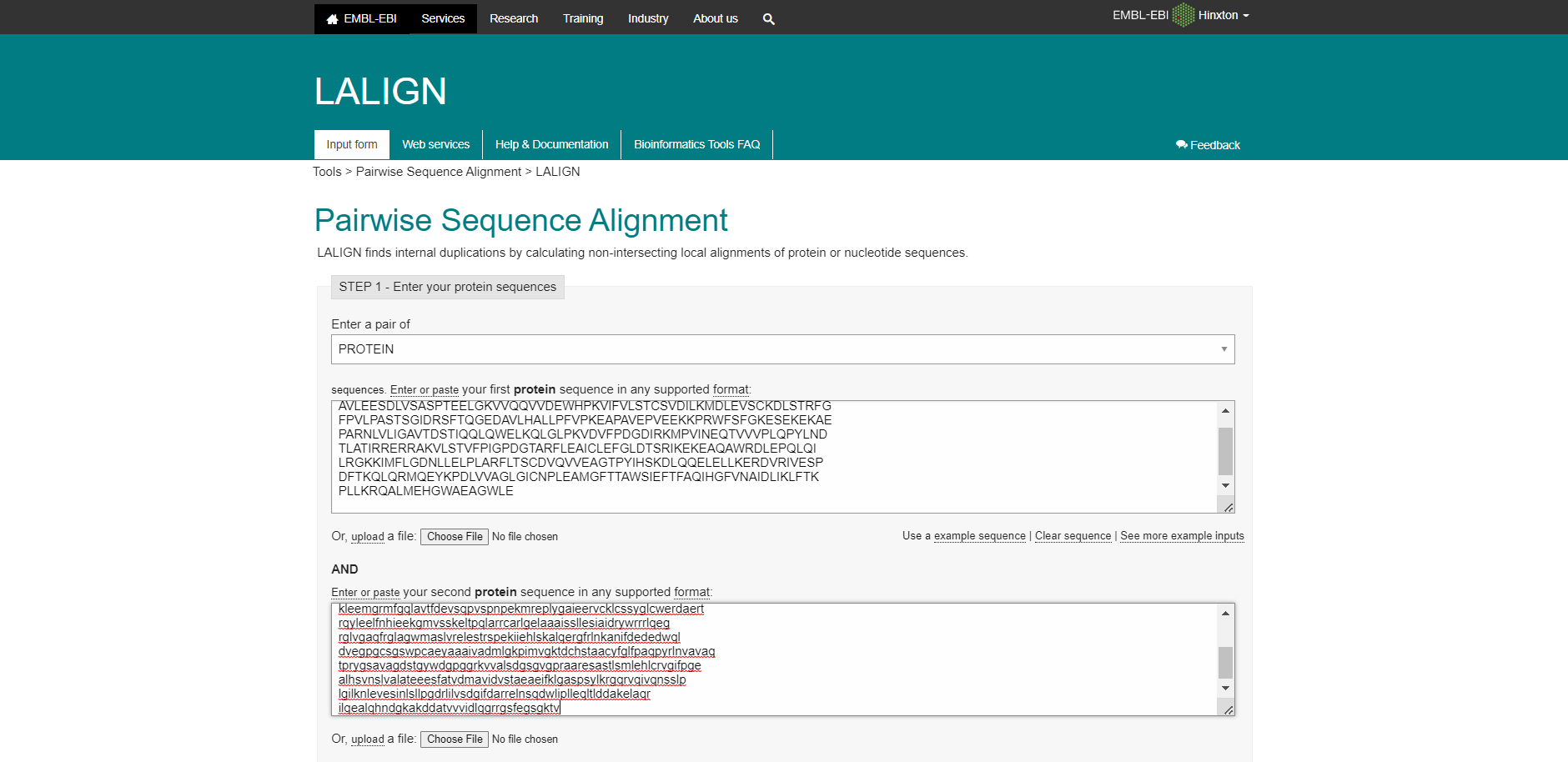
LALIGN Tool

Slide 45
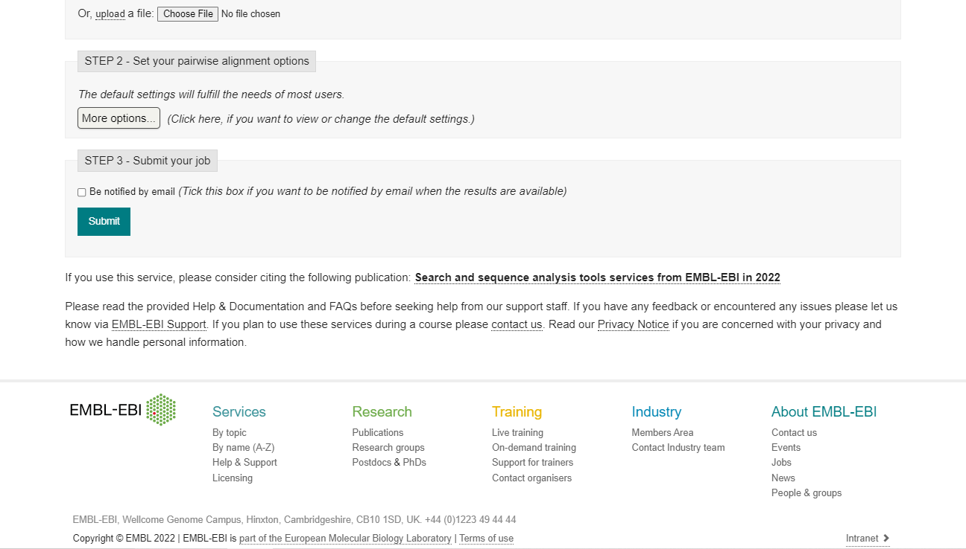
LALIGN Tool

Slide 46
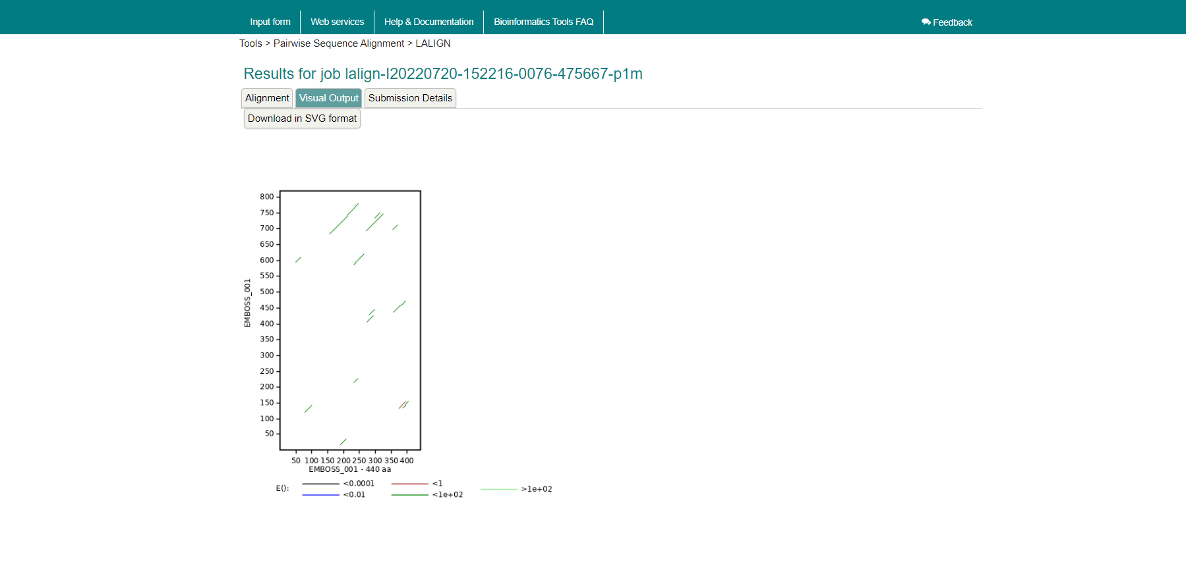
Output Graph

Slide 47
Thanks !

Slide 48
National Center of Research Summer Training Project Two 2022 Bioinformatics
Faculty of Computers and Artificial Intelligence Cairo University
Bioinformatics Department
Third Level

Slide 49
DNA Sequence Classification
Under Supervision of Dr. Enas Khalil
National Center of Research
Done by:
Sarah Hesham 20198047
Mariam Hassan 20198081

Slide 50
Over View
Text data was downloaded from UCI.com .
Text data was converted to excel sheet.
Excel sheet data was processed.
LSTM model application.
Python programming language used.

Slide 51
Objectives
Learn how to manipulate data in a .txt file and convert it to .xlsx or .csv .
What is LSTM and why is used?
Long Short-Term Memory (LSTM) networks are a type of recurrent neural network capable of learning order dependence in sequence prediction problems. This is a behavior required in complex problem domains like machine translation, speech recognition, and more. LSTMs are a complex area of deep learning.

Slide 52
About Our Dataset
Title of Database:
Primate splice-junction gene sequences (DNA) with associated imperfect domain theory.

Slide 53
About Our Dataset
Problem Description: Splice junctions are points on a DNA sequence at which `superfluous' DNA is removed during the process of protein creation in higher organisms. The problem posed in this dataset is to recognize, given a sequence of DNA, the boundaries between exons (the parts of the DNA sequence retained after splicing) and introns (the parts of the DNA sequence that are spliced out). This problem consists of two subtasks: recognizing exon/intron boundaries (referred to as EI sites), and recognizing intron/exon boundaries (IE sites). (In the biological community, IE borders are referred to a ``acceptors'' while EI borders are referred to as ``donors''.)

Slide 54
About Our Dataset
Number of Instances: 1535.
Number of Attributes: 61 -- class (one of EI, IE) -- instance name -- 60 sequential DNA nucleotide positions

Slide 55
About Our Dataset
1) One of {EI ,IE}, indicating the class.
2) The instance name.
3-62) The remaining 60 fields are the sequence, starting at position 30 and ending at position +30.
Each of these fields is almost always filled by one of {a, g, t, c}.

Slide 56
About Our Dataset
Other characters indicate ambiguity among the standard characters according to the following table:
character meaning
D A or G or T
N A or G or C or T
S C or G
R A or G
Missing Attribute Values: none
Class Distribution:
EI: 767 (49.9%) IE: 768 (50.1%)

Slide 57
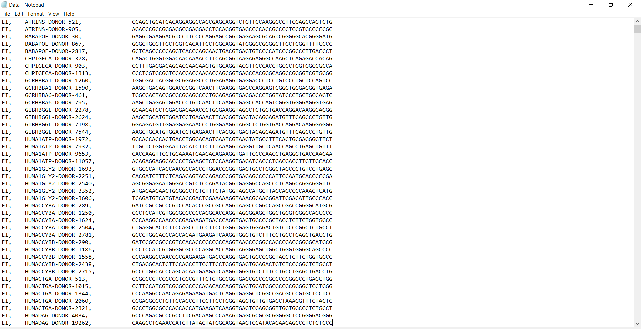
Shape of Dataset Text File

Slide 58
How Data was Processed?
Prediction Column:
Each EI was converted to a 0
Each IE was converted to a 1
Attributes:
Our data set has constant DNA sequences of length 60
So 60 attributes were created having its indices
Each A was converted to 0
Each C was converted to 1
Each G was converted to 2
Each T was converted to 3

Slide 59
What about Garbage?
It was mentioned in the data description that there is no garbage, instead there are some inaccurate values, for example:
character meaning
D A or G or T
N A or G or C or T
S C or G
R A or G
Problem solved by creating an array for each of these four letters including their expected values and a random one was chosen each time from each array at run time .

Slide 60
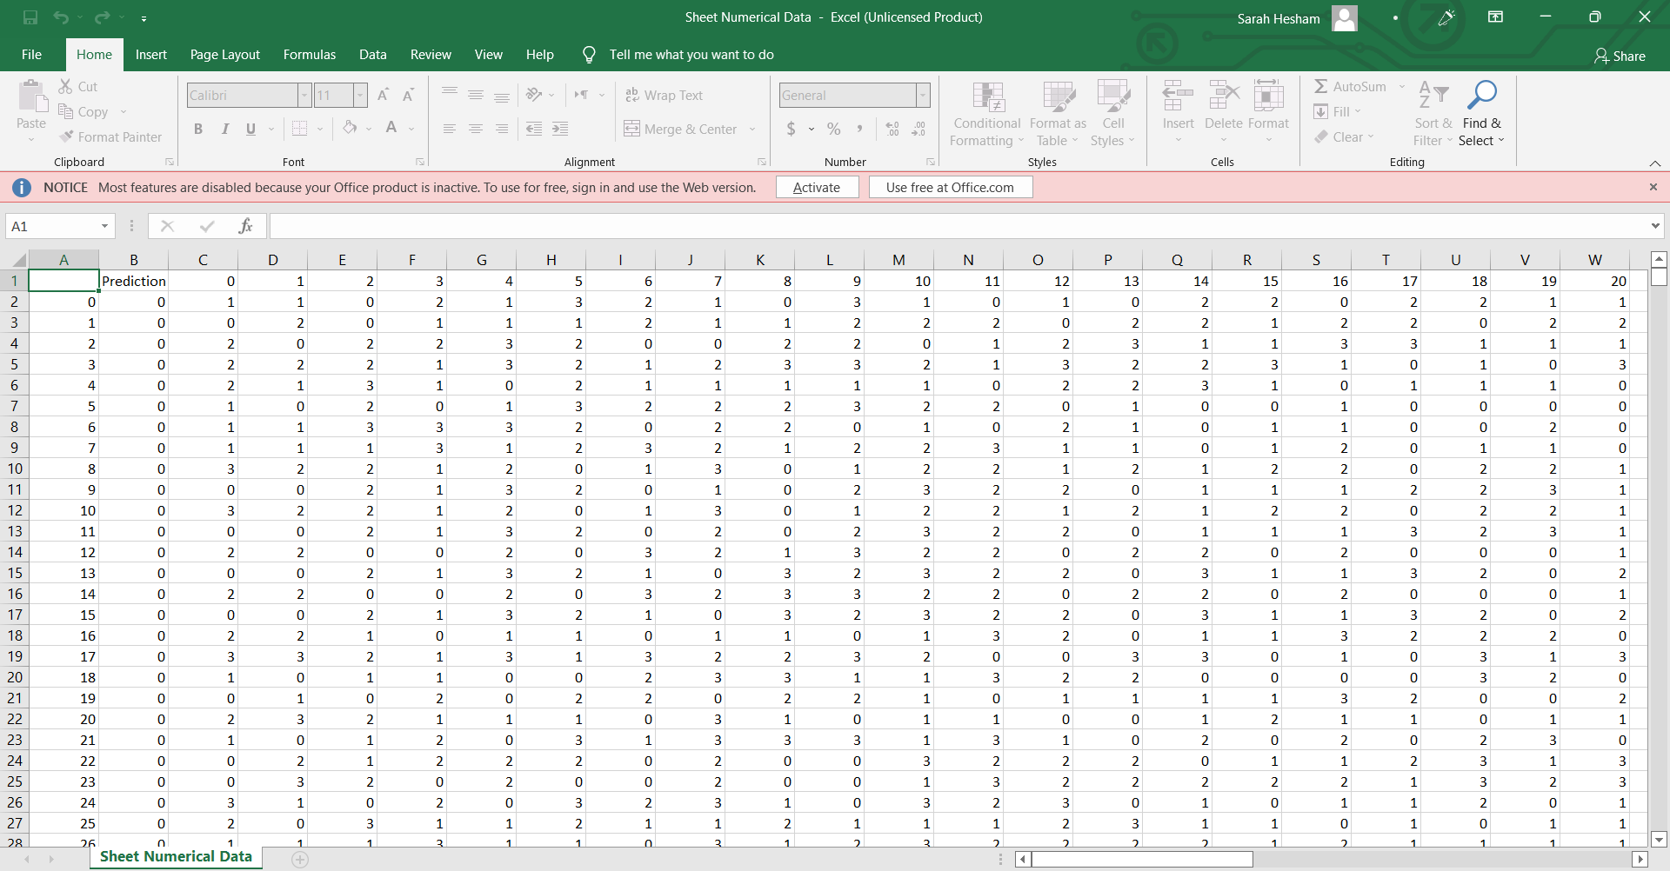
After Conversion to Excel File and Processing it

Slide 61
Applying LSTM model
Train data was 70% and test was 30%
Accuracy was 89.15%

Slide 62
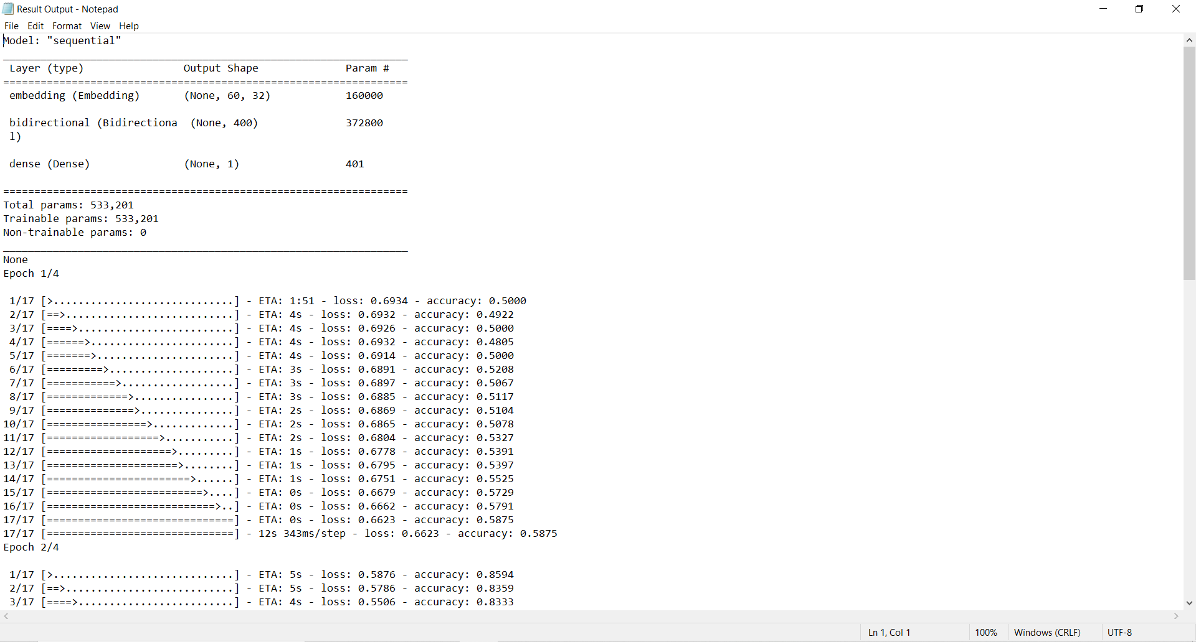
LSTM Output Text File

Slide 63
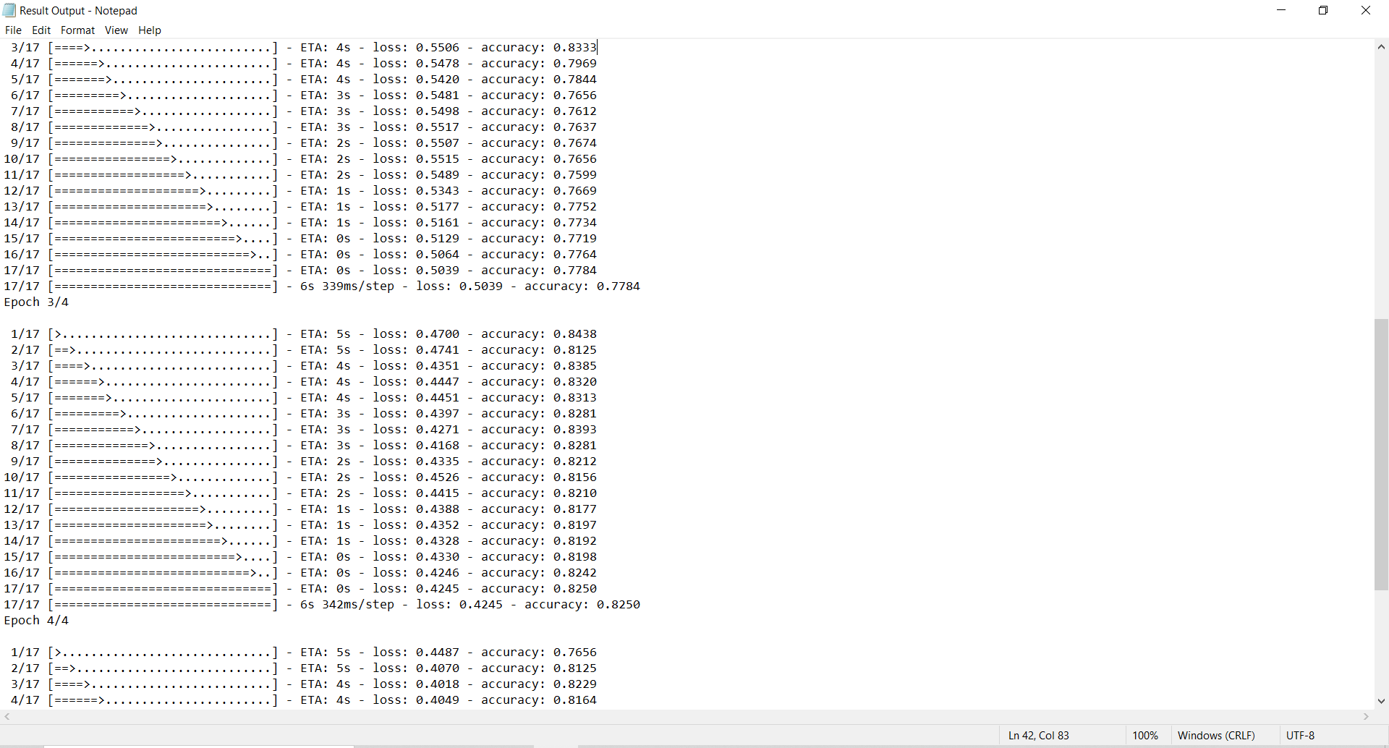
LSTM Output Text File

Slide 64
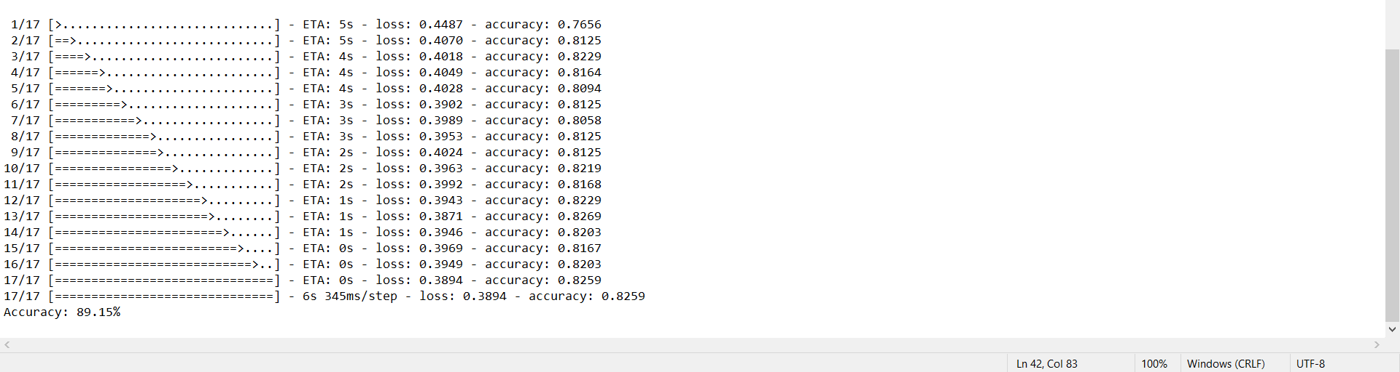
LSTM Output Text File

Slide 65
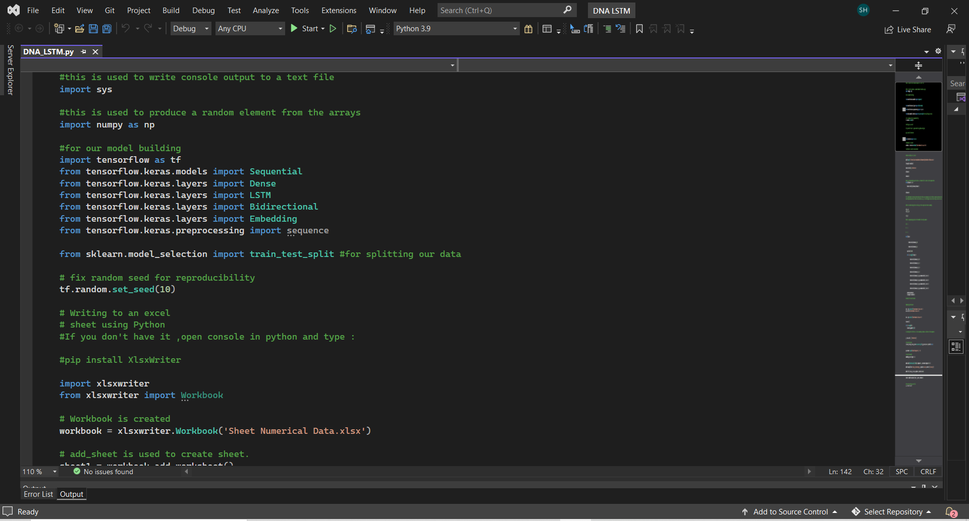
LSTM Python Code

Slide 66
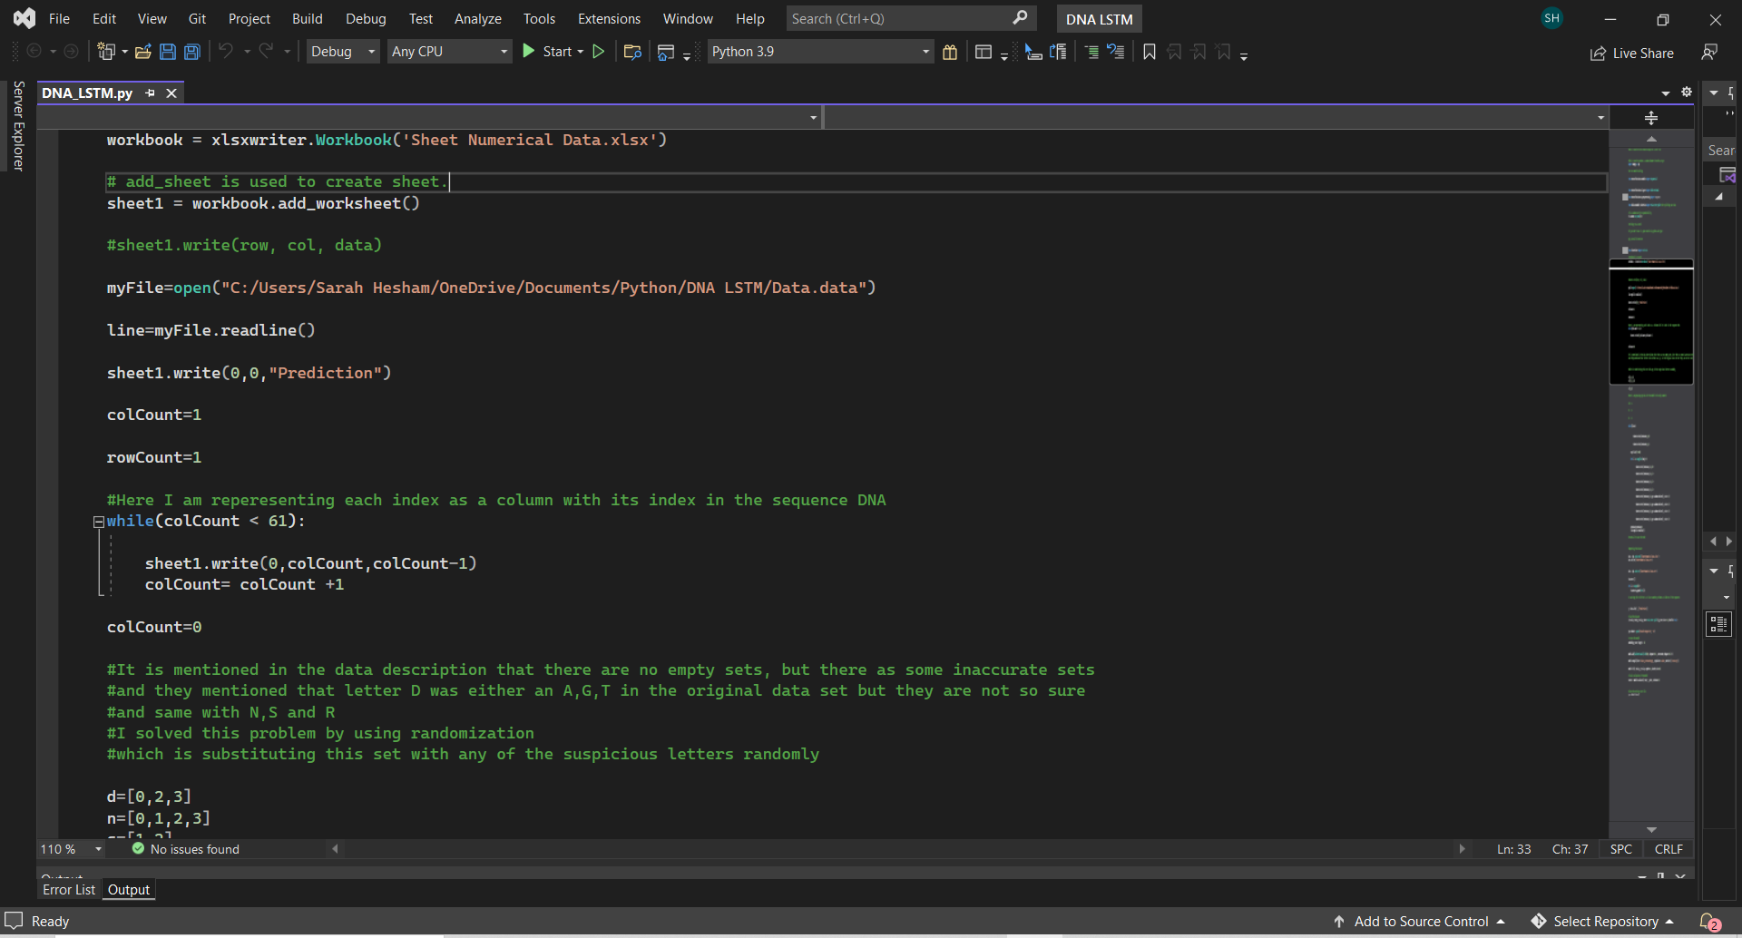
LSTM Python Code

Slide 67
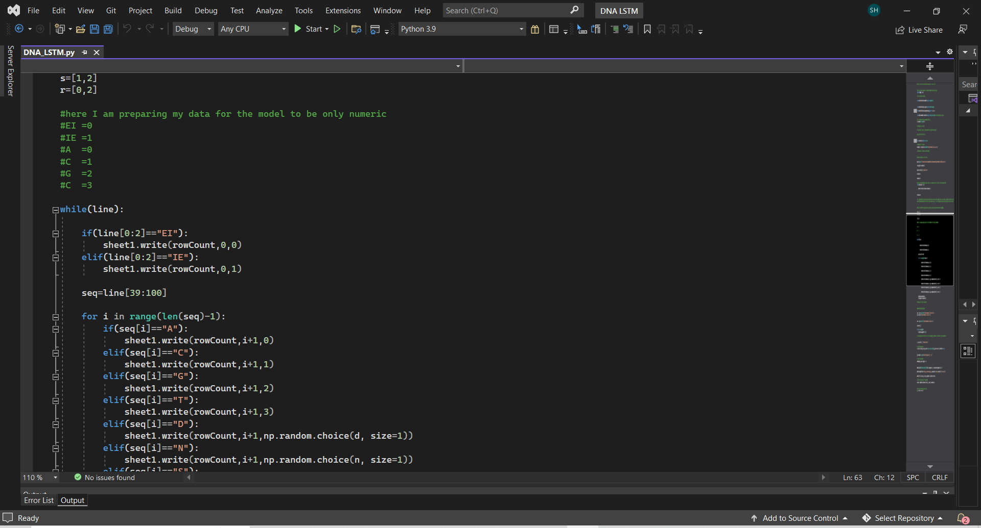
LSTM Python Code

Slide 68
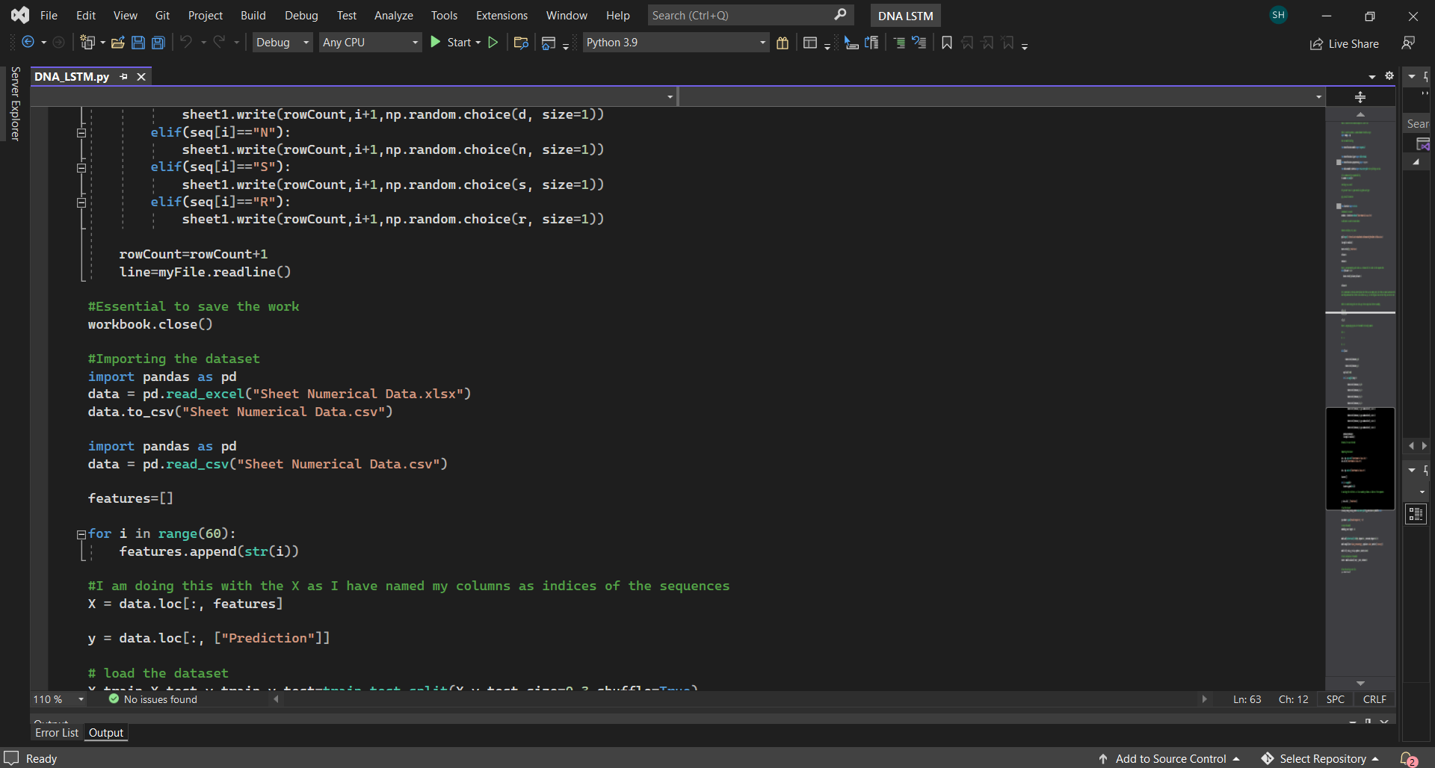
LSTM Python Code

Slide 69
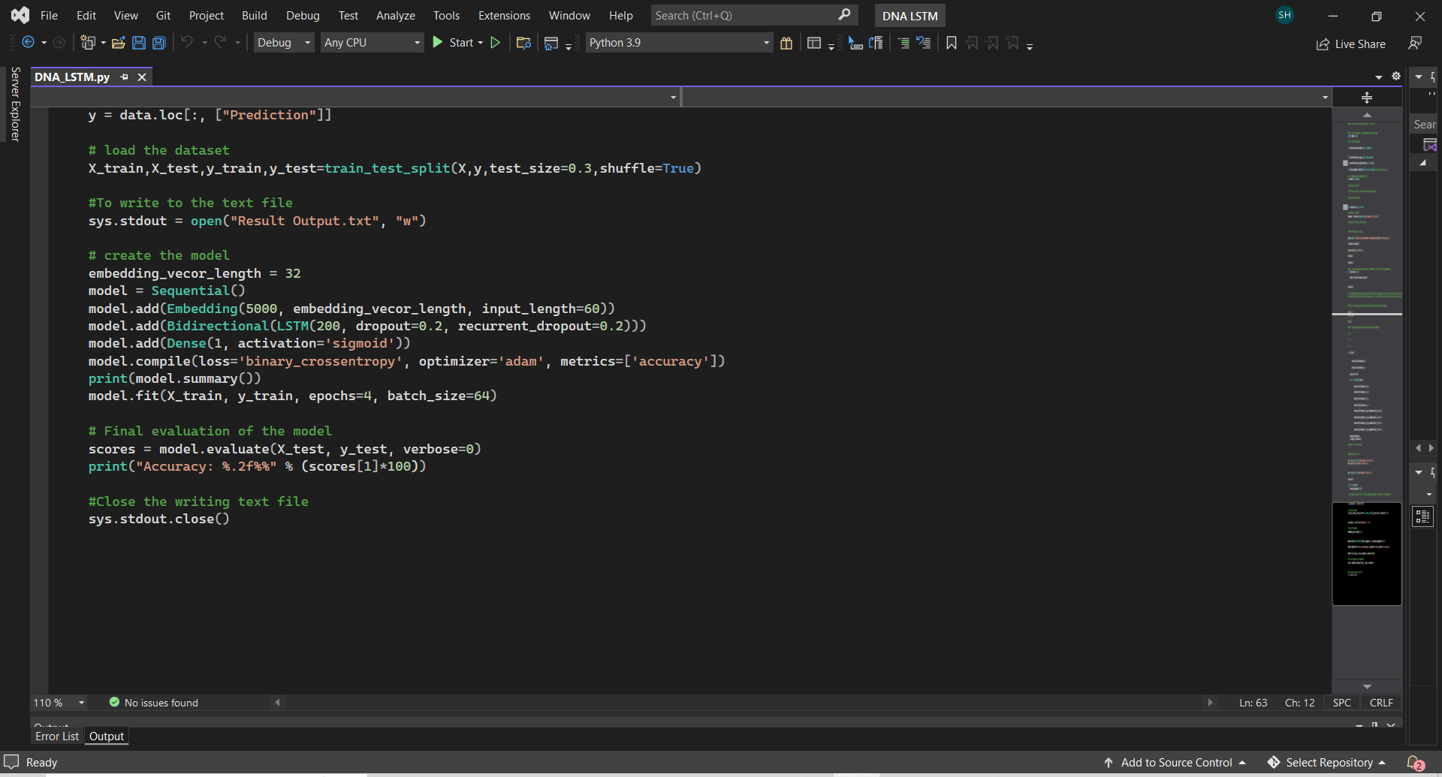
LSTM Python Code

Slide 70
Thanks !

